Slide 1
CheckPoint 360°TM
Client Logo

Slide 2
Just for you: the user
Do you prefer this solid background?
You can change the background using the “layout” tool and select between this one and the white one
Use the “hide slide” feature to hide the slides that you would not be using including this one and the following!

Slide 3
Just for you: the user
Do you prefer this one?
Feel free to change background using the “layout” feature
Color code
Executive Slides
Hiring Mgr /Self
HR
Remember to use the “hide slide” feature to hide the slides that you would not be using including this one!

Slide 4
Who are we?
About Us
Where We Are
Profiles International serves 124 countries around the globe and has material in 32 languages. Profiles International has more than 750 representatives in the U.S. and in more than 90 other countries around the world to serve your needs.

Slide 5
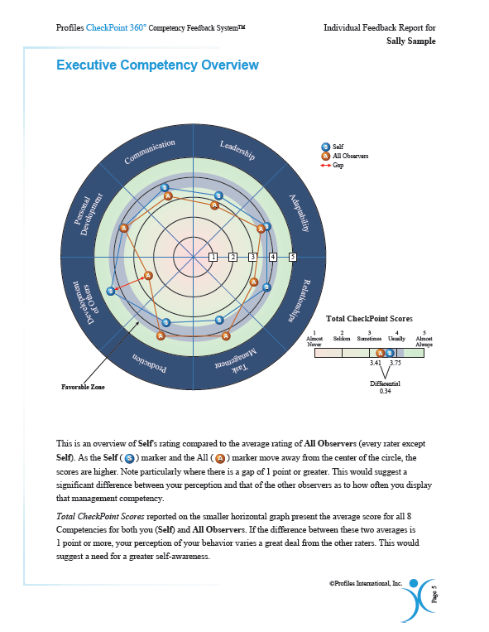
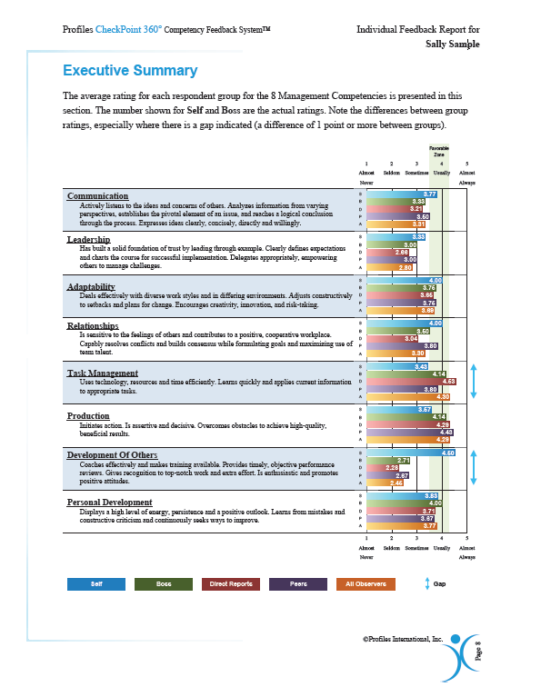
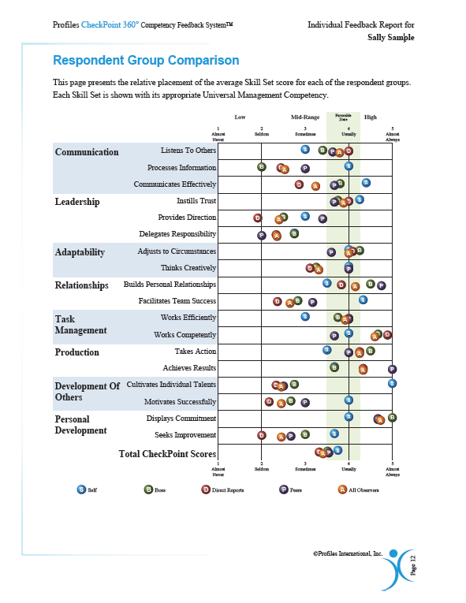
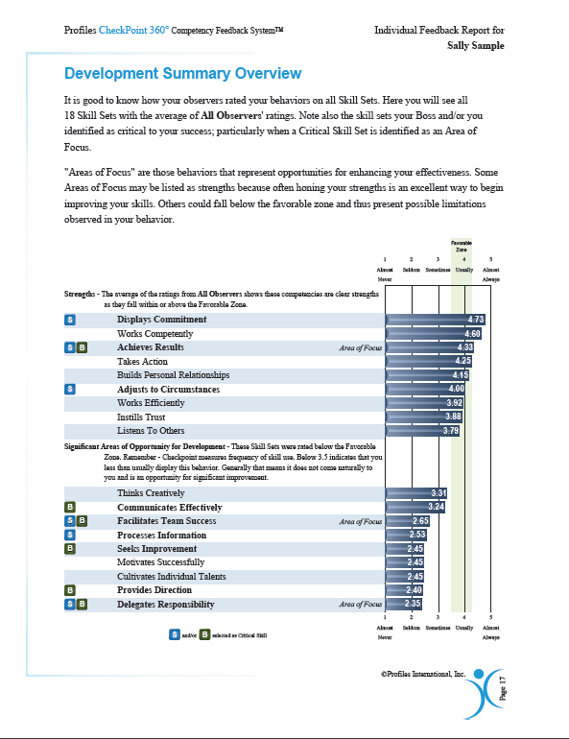
What can CheckPoint 360°TM do for YOU?
Notes:
We can help you take a closer look….

Slide 6
Notes:
Dolphin or Shark? Actually, probably just a dolphin, but we should probably take a closer look and ask a few questions. Let’s put ourselves in this picture. Maybe we are a dolphin and someone can perceive us to be a shark? Or the other way around. If you are trying to accomplish something and people are not perceiving you, your thoughts, goals, intentions accurately we get communication barriers and stalls to progress. What we offer with the Checkpoint is an opportunity to have the discussion and give us a glimpse of how we are being perceived by others. Then we can go to work on either changing the way we function or help us to communicate more effectively to reach our goals, not only as an individual, but as a company. If everyone is your organization took a closer look at themselves and asked a few questions – think of the impact.

Slide 7
CheckPoint 360°™ System
Align Core Competencies
Encourage Growth
Establish Accountability
Increase Profitability
Notes:
Executive slide:
Align Core Competencies: Checkpoint 360 will help you identify those competencies that your Executive and Management team defines as the Core Competencies that will take your organization to the next level. It will help you make sure that your team understands the priorities of your organization at every level.
Increase Profitability: By identifying and discussing priorities at every level, your organization will be able to focus on those areas that will grow business and increase profits.
Establish Accountability: The Checkpoint 360 system will help your organization identify areas of growth needed at each level in your organization, develop Individual Development Plan and compare results in a Comparison Report upon completion of the year. This will help track the progress of the Individual Development Plan and hold people accountable for results.
Ecourage Growth: The Checkpoint 360 will allow your employees and their managers to have an honest and open discussion about their positions and how they are being perceived within your organization. It will encourage growth, not only individually, but within departments and collectively as an entire organization.

Slide 8
CheckPoint 360°™ System
Clarify Expectations
Enhance Communication
Increase Productivity
Establish Accountability
Notes:
Hiring Manager/HR slides
Clarify Expectations: The Checkpoint 360 will allow your Managers to clarify their expectations for each of their Direct Reports. It will create an opportunity for a discussion regarding the most important competencies in each position. It allows both Manager and Direct Report to discuss their understanding of the most critical skills necessary for any given role.
Enhance Communication: This tool will give Managers/Direct Reports a starting point for potentially challenging topics of discussion and help less experienced managers learn to coach their direct reports.
Increase Productivity: The Checkpoint 360 will allow your employees to pinpoint those key areas that will help them be more successful and allow them to concentrate on those improvements that will make them more productive and most successful.
Establish Accountability: The Checkpoint 360 system will help your organization identify areas of growth needed at each level in your organization, develop Individual Development Plan and compare results in a Comparison Report upon completion of the year. This will help track the progress of the Individual Development Plan and hold people accountable for results.

Slide 9
CheckPoint 360°™ System
Clarify Expectations
Enhance Communication
Increase Productivity
Establish Accountability
In an easy to administer process!
Notes:
HR/HR Administration slides:
Clarify Expectations: The Checkpoint 360 will allow your Managers to clarify their expectations for each of their Direct Reports. It will create an opportunity for a discussion regarding the most important competencies in each position. It allows both Manager and Direct Report to discuss their understanding of the most critical skills necessary for any given role.
Enhance Communication: This tool will give Managers/Direct Reports a starting point for potentially challenging topics of discussion and help less experienced managers learn to coach their direct reports.
Increase Productivity: The Checkpoint 360 will allow your employees to pinpoint those key areas that will help them be more successful and allow them to concentrate on those improvements that will make them more productive and most successful.
Establish Accountability: The Checkpoint 360 system will help your organization identify areas of growth needed at each level in your organization, develop Individual Development Plan and compare results in a Comparison Report upon completion of the year. This will help track the progress of the Individual Development Plan and hold people accountable for results.
EASY TO ADMINISTER: This system is easy to administer and easy to implement. You will see later in our presentation that all of the information is easy to access in a site specifically designed to house your organizations information. Easy to access and easy to utilize!

Slide 10
Objectives
What is the Checkpoint 360™ and what does it measure
Reviewing the different reports
Real World Applications
Demonstrated Results with examples
Getting you Started

Slide 11
What is the CheckPoint 360°TM ?

Slide 12
CheckPoint 360°™
True Survey
Asks for individuals’ perceptions about what they have observed
Self-assessment
Asks individuals to rate themselves
More objective and useful than single-point performance evaluations
Likert type responses
Notes:
Likert Scale
by Saul Mcleod, published 2008
Various kinds of rating scales have been developed to measure attitudes directly (i.e. the person knows their attitude is being studied). The most widely used is the Likert Scale.
Likert (1932) developed the principle of measuring attitudes by asking people to respond to a series of statements about a topic, in terms of the extent to which they agree with them, and so tapping into the cognitive and affective components of attitudes.
Likert-type or frequency scales use fixed choice response formats and are designed to measure attitudes or opinions (Bowling 1997, Burns & Grove 1997). These ordinal scales measure levels of agreement/disagreement.
A Likert-type scale assumes that the strength/intensity of experience is linear, i.e. on a continuum from strongly agree to strongly disagree, and makes the assumption that attitudes can be measured. Respondents may be offered a choice of five to seven or even nine pre-coded responses with the neutral point being neither agree nor disagree.
In it final form, the Likert Scale is a five (or seven) point scale which is used to allow the individual to express how much they agree or disagree with a particular statement.
For example:
I believe that ecological questions are the most important issues facing human beings today.
Strongly agree / agree / don’t know / disagree / strongly disagree
Each of the five (or seven) reponses would have a numerical value which would be used to measure the attitude under investigation

Slide 13
CheckPoint 360°TM System
‘Self’
Direct Reports
Each Leader/ Manager
‘Boss’
Anonymous
& Confidential
Peers
Anonymous
& Confidential
Notes:
13
To measure your Leadership Charisma we use an online system called Checkpoint.
The Checkpoint has a behavioral model that includes 70 very clear leader behaviors – things like ‘Listen carefully without interrupting’, ‘Gives recognition to producers of high quality work’, ‘Keeps a positive outlook’ and so on. These 70 behaviors have been shown to be those that highly successful, and charismatic, leaders share in common. Every year we assess hundreds of thousands of leaders worldwide using the model.
The approach is straightforward. <CLICK> First we ask the people who work for you, your ‘Direct Reports’, to rate you on each of these 70 behaviors. Then we have you rate yourself on those behaviors <CLICK>. Finally we ask your boss and your peer managers to rate you too <CLICK). Other than your Boss's input the other raters get to provide their feedback to you on completely confidential and anonymous basis. It takes each person just 15 minutes online to provide this input – and it’s all online for convenience. <CLICK>
13

Slide 14
Observed Behaviors
Observable behavior is the key
Behavior is observed from all perspectives
Multiple relationships may be included
Supervisory
Subordinate
Peer
Other (customer or client)

Slide 15
Confidentiality
Confidentiality of respondents MUST be assured and maintained
No respondent group has fewer than two individuals
Even a hint of or rumor about a lack of confidentiality can render information useless

Slide 16
What we don’t want to hear!
“I wonder how Bob will answer the question about sharing information when he is rating Julie?”
“I bet that Betty gets great marks from her Direct Reports!”
“I’m sure that Andrew will show up as very charismatic!”
“What did you answer to question 12 when you filled the CheckPoint out on David? I only gave him a 2.”
“I don’t know if this CheckPoint thing will work for the Software Development Department. I would love to see their responses.”

Slide 17
What does the CheckPoint 360°TM Measure?

Slide 18
Key Skill Sets
Communication:
Listens to Others
Processes Information
Communicates Effectively
Leadership:
Instills Trust
Provides Direction
Delegates Responsibility
Adaptability:
Adjusts to Circumstances
Thinks Creatively
Relationships:
Builds Personal Relationships
Facilitates Team Success
Task Management:
Works Efficiently
Works Competently
Production:
Takes Action
Achieves Results
Development of Others:
Cultivates Individual Talents
Motivates Successfully
Personal Development:
Displays Commitment
Seeks Improvement
Notes:
This slides is for all three audiences as an overview of what the Checkpoint measures. Briefly talk about the importance of each area in leadership.

Slide 19
What else does it measure?
Leadership Charisma
Leadership Charisma Index (LCI)
Leadership Charisma Quotient (LCQ
Notes:
This slide is for all three audiences. Talk about what leadership charisma is.

Slide 20
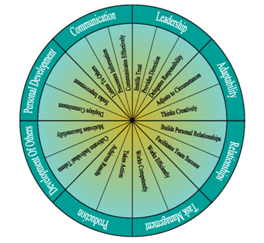
Key Skill Sets
A closer look
Notes:
This sections defines each of the competencies and specific skill sets. Used by the HR team and Hiring Manager/Self.

Slide 21
Universal Management Competencies
Communication
Actively listens to the ideas and concerns of others. Analyzes information from varying perspectives, establishes the pivotal element of an issue, and reaches a logical conclusion through the process. Expresses ideas clearly, concisely, directly and willingly.
Leadership
Has built a solid foundation of trust by leading through example. Clearly defines expectations and charts the course for successful implementation. Delegates appropriately, empowering others to manage challenges.

Slide 22
Universal Management Competencies
Adaptability
Deals effectively with diverse work styles and in differing environments. Adjusts constructively to setbacks and plans for change. Encourages creativity, innovation, and risk-taking.
Relationships
Is sensitive to the feelings of others and contributes to a positive, cooperative workplace. Capably resolves conflicts and builds consensus while formulating goals and maximizing use of team talent.

Slide 23
Universal Management Competencies
Task Management
Uses technology, resources and time efficiently. Learns quickly and applies current information to appropriate tasks.
Production
Initiates action. Is assertive and decisive. Overcomes obstacles to achieve high-quality, beneficial results.

Slide 24
Universal Management Competencies
Development of Others
Coaches effectively and makes training available. Provides timely, objective performance reviews. Gives recognition to top-notch work and extra effort. Is enthusiastic and promotes positive attitudes.
Personal Development
Displays a high level of energy, persistence and a positive outlook. Learns from mistakes and constructive criticism and continuously seeks ways to improve.

Slide 25
Universal Management Competencies
Leadership Charisma
Creates and maintain a work environment where people are emotionally and intellectually committed to the organization's goals. Builds an energetic and positive attitude in others and inspire them to do their very best. Creates a common sense of purpose.

Slide 26
Communication
Listens to Others
Encourages others to share their ideas and concerns. Listens openly to all viewpoints without interrupting. Summarizes information and verifies understanding.
Processes Information
Gets to the point. Evaluates the pros and cons, as well as the short and long-range consequences, of decisions. Develops logical, clear conclusions.
Communicates Effectively
Expresses self clearly, both in writing and in speaking. Is thorough, yet concise, and is consistently straightforward. Readily shares information with others.

Slide 27
Leadership
Instills Trust
Can be trusted to keep promises and confidences. Is honest and ethical.
Provides Direction
Establishes clear expectations and a manageable workload. Plans the steps required to accomplish objectives, while keeping focus on overall vision.
Delegates Responsibility
Delegates appropriate jobs to appropriate people. Empowers others to work and solve problems on their own.

Slide 28
Adaptability
Adjusts to Circumstances
Can adjust to people‘s diverse work styles and to varying environments. Deals with setbacks constructively and anticipates change.
Thinks Creatively
Brings an imaginative approach to the job, inspiring innovation, risk-taking, and creative problem-solving.

Slide 29
Relationships
Builds Personal Relationships
Is considerate of others' feelings, shows freedom from unfair biases and is tactful when giving criticism. Remains composed under stress.
Facilitates Team Success
Resolves conflicts fairly in a spirit of cooperation. Builds consensus and leads team in setting appropriate goals. Recruits effectively and uses talents of group wisely.

Slide 30
Task Management
Works Effectively
Makes efficient use of current technology and wise use of outside resources. Avoids procrastination and sets priorities.
Works Competently
Has mastered the fundamentals of the job. Can quickly and competently apply new methods and new information to appropriate tasks.

Slide 31
Production
Takes Action
Knows when the time is right to initiate action. Handles problems with assertiveness and makes timely, firm decisions.
Achieves Results
Overcomes obstacles to achieve results that set high standards for others and that positively impact the organization.

Slide 32
Development of Others
Cultivates Individual Talents
Is an effective coach and makes training available. Provides objective performance feedback on a timely basis.
Motivates Successfully
Gives recognition to people who produce excellent work and give extra effort. Has an enthusiastic attitude that positively affects others.

Slide 33
Personal Development
Displays Commitment
Maintains a high level of energy, perseveres, and remains positive.
Seeks Improvement
Learns positive lessons from mistakes and constructive criticism. Pursues resources to improve and develop professionally. Sets no limits on personal potential.

Slide 34
Leadership Charisma
Leadership Charisma Index (LCI) Perceived charisma by direct reports.
Leadership Charisma Quotient (LCQ) Leadership Charisma Index compare to nationwide standards.

Slide 35
Frequency of Observed Behavior
Rating | Description | Percent of Time
1 | Almost Never | 0 – 10%
2 | Seldom | 11 – 39%
3 | Sometimes | 40 – 60%
4 | Usually | 61 – 89%
5 | Almost Always | 90 – 100%
N | No opportunity to observe behavior

Slide 36
CheckPoint 360°TM reports
A Uniquely Complete System

Slide 37
CheckPoint 360°TM Reports
Individual Feedback Report
Management Report
Management Comparison Report
Comparison Report
Executive Overview
Leadership Charisma Report
Notes:
Highlight the reports as they pertain to the audience presenting

Slide 38
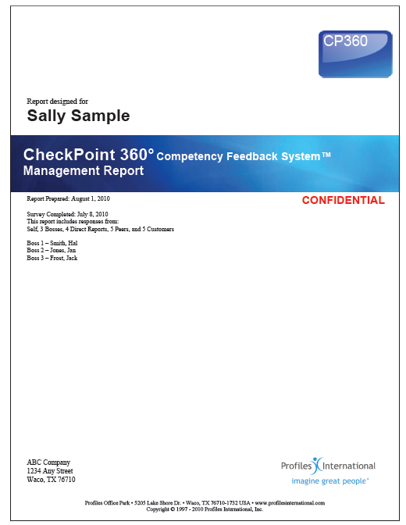
CheckPoint 360°™
Report

Slide 39
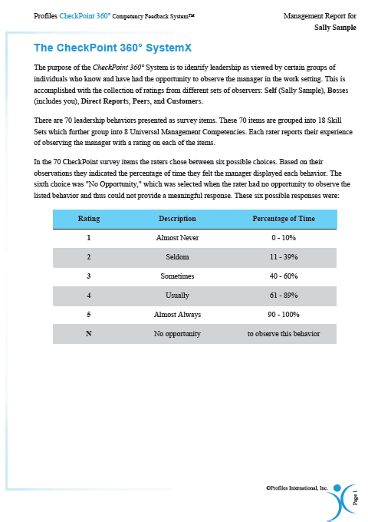
Scoring
1 to 5 Scale
Measuring the frequency of display
Not Applicable is an option
*Note- answers of not applicable are not averaged into the score

Slide 40
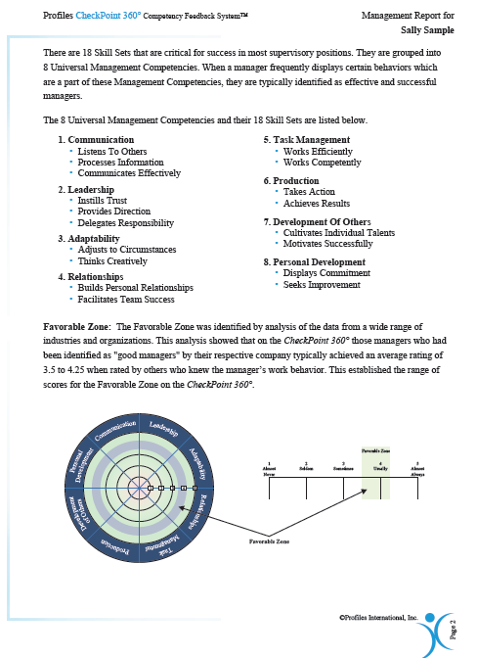
CheckPoint 360 Feedback
8 Universal Leadership Competencies
18 Leadership Skill Sets
Favorable Zone
3.5 to 4.25

Slide 41
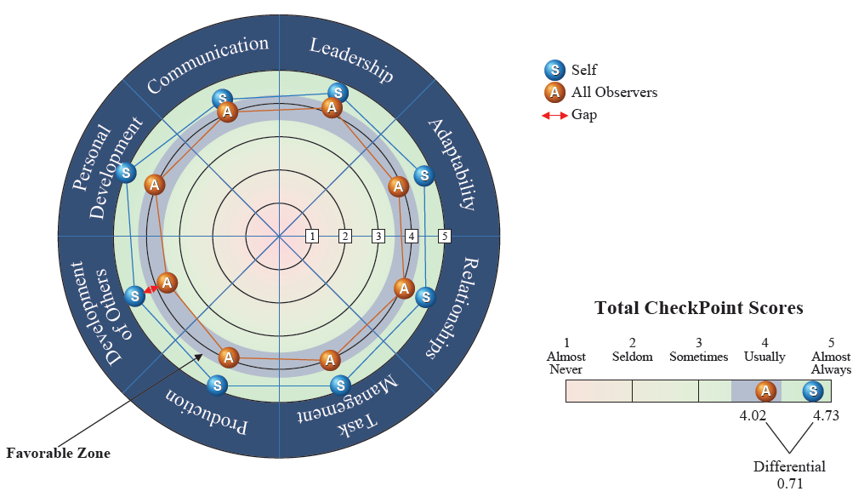
Individual Manager Level:
Current Status
How am I being perceived
as a leader?
Notes:
41

Slide 42
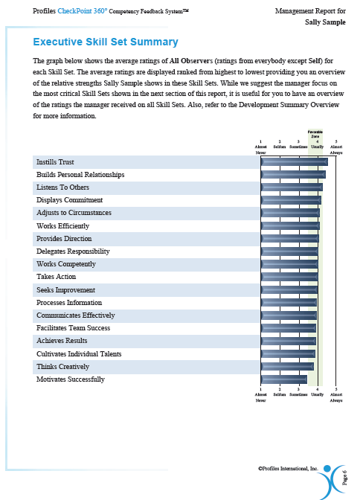
Executive Skill Set Summary
1. 18 Leadership Skills
Stack rank from most frequent to least frequent
Average of All Observers (excluding Self)
Compared to Favorable Zone

Slide 43
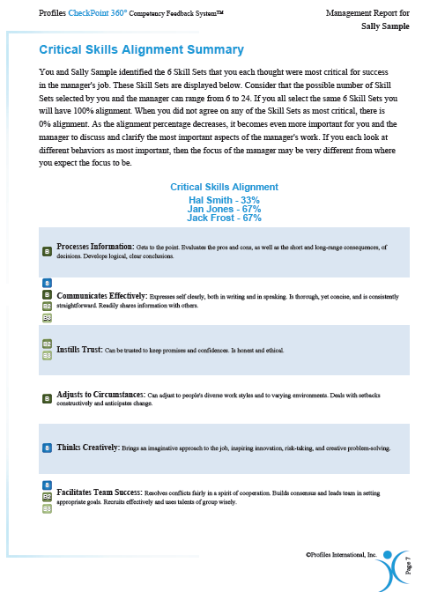
Critical Skills Alignment Summary
Skills that are determined to be critical to the leadership position
Chosen by:
Self
Boss
Additional Bosses if applicable
Identifies areas of strong alignment
Illustrates areas of weak alignment
Percentage alignment with boss/bosses
Starting point for Development Plan

Slide 44
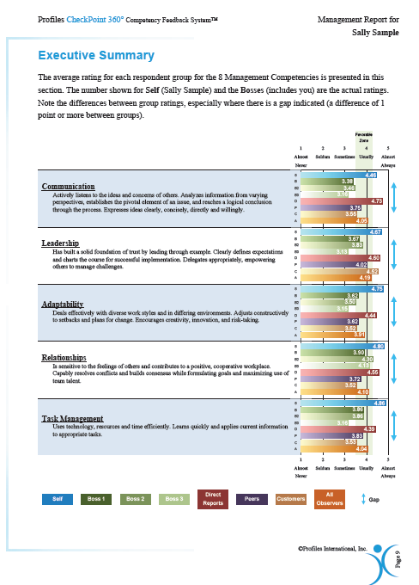
Executive Summary
Average rating for each Management Competency
Each Respondent group is represented
My perceptions of My performance versus:
Boss/Bosses
Peers
Direct Report
Identifies significant gaps between highest & lowest respondent groups

Slide 45
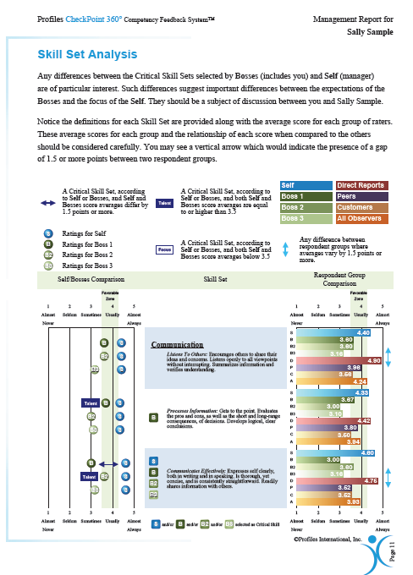
Skill Set Analysis
Where do you rate on the identified critical Skills/Competencies?
Are you in alignment with your boss/bosses?
What skills are considered:
Talents
Focus areas
Where are there gaps in the respondent groups for the identified critical skill sets

Slide 46
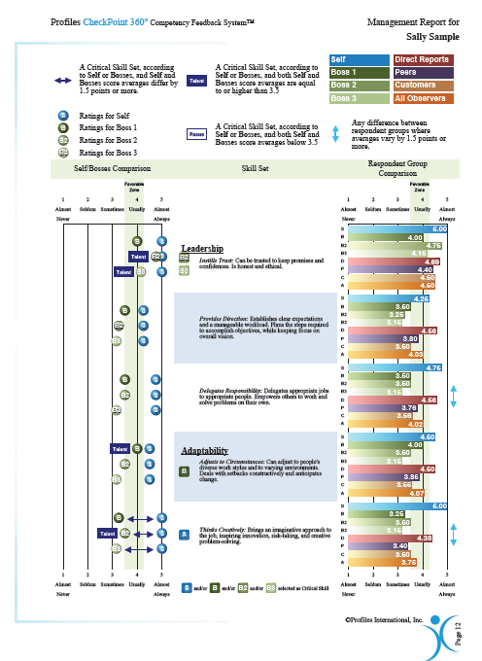
Skill Set Analysis
What is the most important respondent group?
Boss/Bosses
Direct Reports
Peers
Other/Customized Groups
The reality is that you have multiple messages and each of those messages will help you in achieving your leadership objectives and improving results

Slide 47
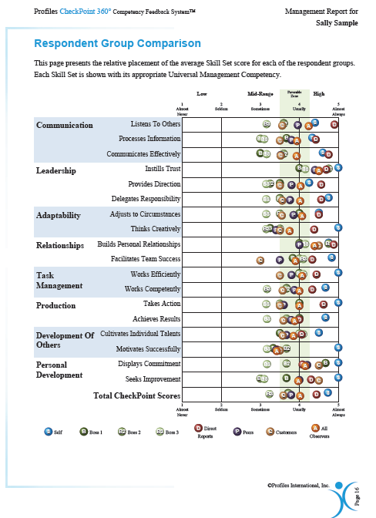
Respondent Group Comparison
Visual Graph to help you recognize:
Trends
Unique scores

Slide 48
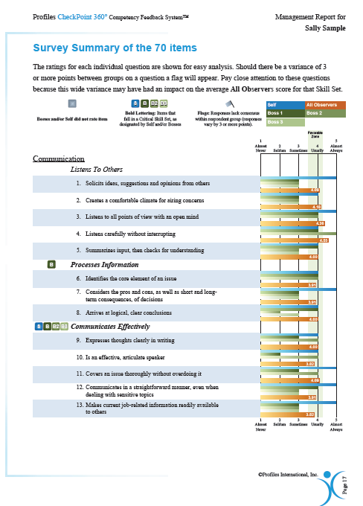
Survey Summary of the 70 Survey Items
Each question that all respondents answered
Critical Skills are identified
Targeted & Actionable tasks that you can implement today
Focused tasks that can help you pin point the action that can help you develop into a stronger leader
All Observers average scores
Includes each group excluding the self score
Identifies scores that lack consensus

Slide 49
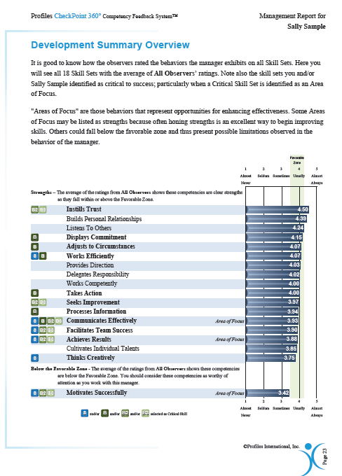
Development Summary Overview
1. 18 Leadership Skills
Stack rank from most frequent to least frequent
Average of All Observers (excluding Self)
Critical Skills identified
Skills that are scored:
Strengths- meeting or exceeding the favorable zone
Development Areas- below the favorable zone
Areas of Focus identified

Slide 50
Coaching & Management Considerations
Section 9 of the Management Report

Slide 51
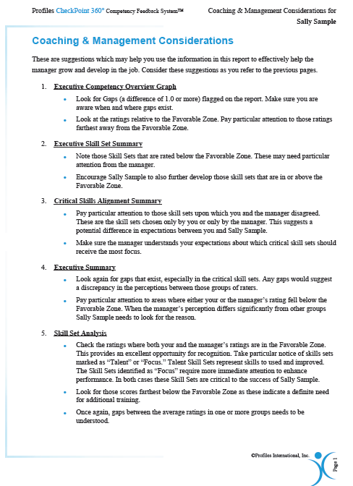
Coaching & Management Considerations
How to leverage each section of the report
Help the manager grow & develop in the job
Guide for you to prepare to meet with the manager

Slide 52
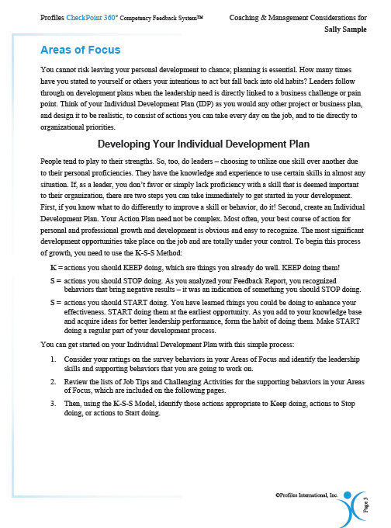
Areas of Focus
Leadership Skills from the CheckPoint 360
Specifically, the skills in the section were identified in the Development Summary Overview
Development Plan
Keep doing
Stop doing
Start doing
Skills, Behaviors, & Attitudes to Adapt and Practice
Challenging Activities

Slide 53
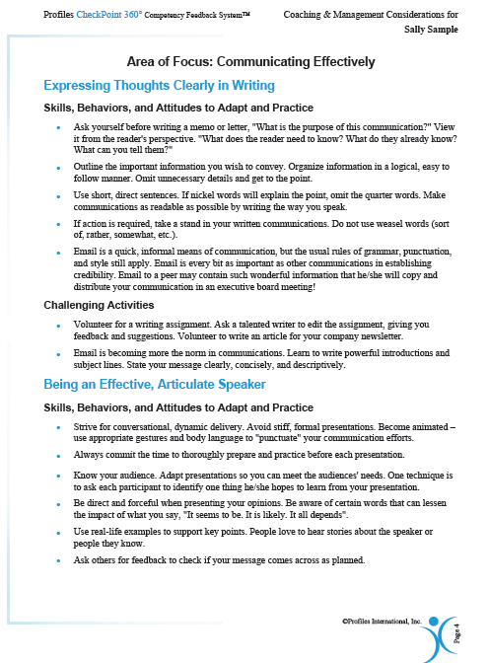
Areas of Focus
Leadership Skills from the CheckPoint 360
Specifically, the skills in the section were identified in the Development Summary Overview
Development Plan
Keep doing
Stop doing
Start doing
Skills, Behaviors, & Attitudes to Adapt and Practice
Challenging Activities

Slide 54
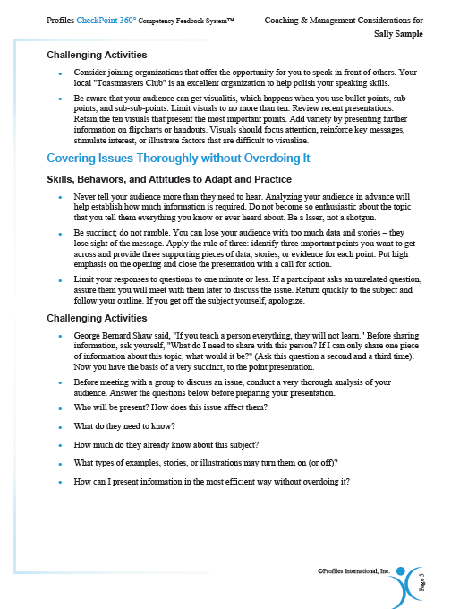
Areas of Focus
Leadership Skills from the CheckPoint 360
Specifically, the skills in the section were identified in the Development Summary Overview
Development Plan
Keep doing
Stop doing
Start doing
Skills, Behaviors, & Attitudes to Adapt and Practice
Challenging Activities

Slide 55
Coaching & Management Considerations
Section 10 of the Individual Feedback Report

Slide 56
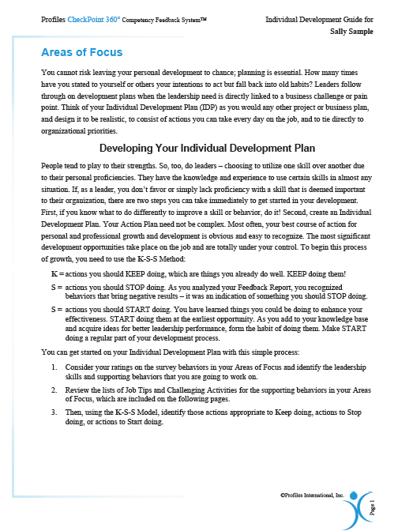
Areas of Focus
Leadership Skills from the CheckPoint 360
Specifically, the skills in the section were identified in the Development Summary Overview
Development Plan
Keep doing
Stop doing
Start doing
Skills, Behaviors, & Attitudes to Adapt and Practice
Challenging Activities

Slide 57
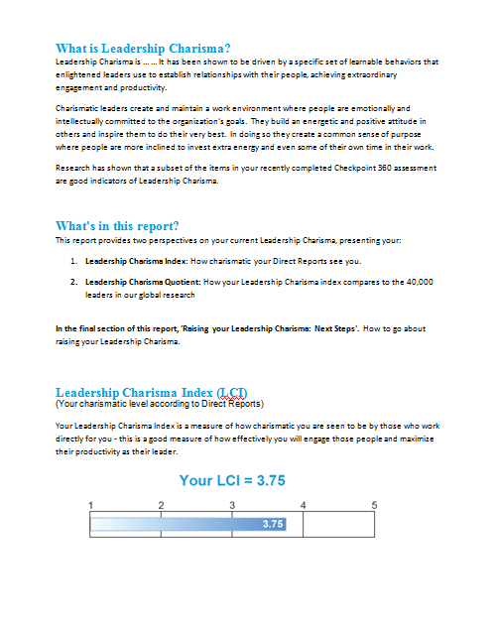
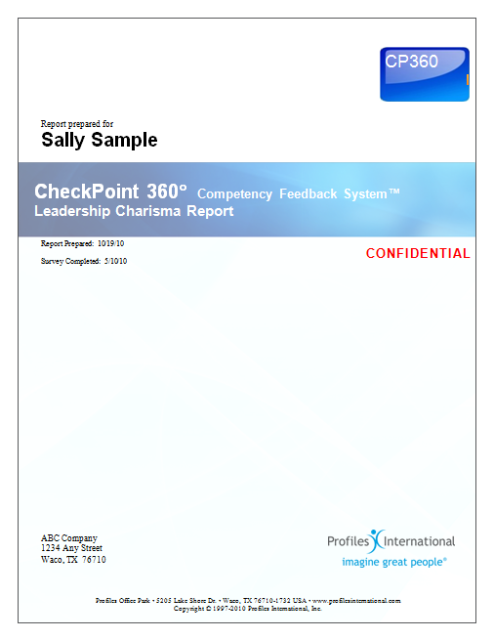
Leadership Charisma Index (LCI)
(Your charismatic level according to Direct Reports)
Your Leadership Charisma Index is a measure of how charismatic you are seen to be by those who work directory for you – this is a good measure of how effectively you will engage those people and maximize their productivity as their leader.
Your LCI = 3.75

Slide 58
Sample Applications
Leadership Development
Executive Coaching
Performance Management/Improvement
Establish Baseline for Ongoing Development Process
Assess Corporate (Leadership) Culture
Leadership Competency Model
Assess Leadership Charisma
Performance
Improvement
Notes:
Note to User: select one of the application and explain a recent one that you have experience or that relates to client type of buss.
For Example: I recently had a client utilize the Checkpoint 360 System to provide Leadership Development for their Manager and Supervisory level employees. They knew that it was important for the Senior Level team to be fully engaged in the process in order to encourage participation at all levels. The Senior Exec team, including all owners and C-Suite level employees decided to participate in the program before enrolling their Manager and Supervisor teams. They found that although they originally intended to focus on the Supervisory and Management teams, that the tools was valuable at any level. They each went on to utilize the Individual Development plan in their own way. During the process The Executive Overview was presented at the Board meeting for the company and it provided a very clear direction for the company at the highest levels in the organization. By utilizing this tool at every level, the managers will have a clear understanding that this is something that the organization will continue to utilize at every level.

Slide 59
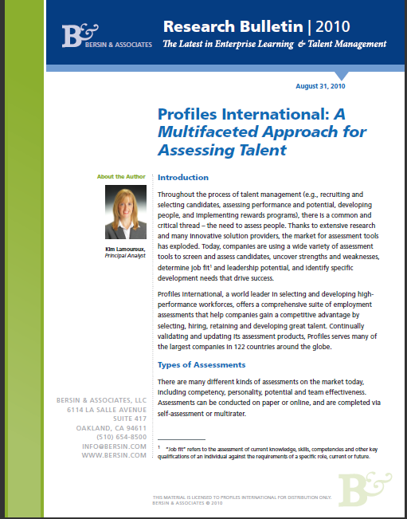
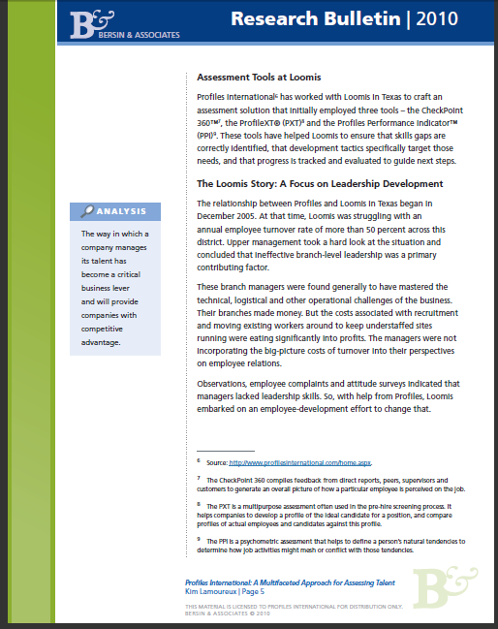
Demonstrated Results
The Loomis uses Leadership Development
Multinational cash-handling corporation; known for its armored transport service
roughly 3,000 armored trucks and other vehicles in the U.S.; providing secure delivery of cash and coin to financial institutions and other businesses
400 operating locations in the U.S.
The Challenge: 50% turnover rate
The Approach: Leadership Development
Assessments: CheckPoint 360™ , the ProfileXT® (PXT) and the Profiles Performance Indicator™ (PPI) .
The Results:
Over 20% turnover reduction: costs have fallen from more than $100,000 to $20,000 to $30,000 annually – and that amount is largely just to keep an advertising presence
Improved Management & Leadership
A culture of Engagement
Notes:
The relationship between Profiles and Loomis in Texas began in December 2005. At that time, Loomis was struggling with an annual employee turnover rate of more than 50 percent across this district. Upper management took a hard look at the situation and concluded that ineffective branch-level leadership was a primary contributing factor.
These branch managers were found generally to have mastered the technical, logistical and other operational challenges of the business. Their branches made money. But the costs associated with recruitment and moving existing workers around to keep understaffed sites running were eating significantly into profits. The managers were not
incorporating the big-picture costs of turnover into their perspectives
on employee relations.
Observations, employee complaints and attitude surveys indicated that
managers lacked leadership skills. So, with help from Profiles, Loomis
embarked on an employee-development effort to change that.

Slide 60
Getting Started
Send letter informing respondents they’ve been chosen to participate in Checkpoint360 Survey
Collect Respondent info and e-mail addresses on Respondent Spreadsheet.
Establish start and completion dates for Survey
Send Invitations
Notes:
Gives step by step guidelines for a site administrator to start the process

Slide 61
Upon Completion
Send final reminders to ensure completion by scheduled close date
Upon completion, schedule debrief with Hiring Manager/Boss
Have Boss schedule their private debrief with Self
Notify Executive when all Surveys are complete
Notes:
This outlines steps taken by site administrator upon completion.

Slide 62
Getting Started
Inform Self of upcoming Survey
Select Respondents- Peers, Direct Reports, others, Second Boss if needed
Determine start/close dates
Complete participant spreadsheet and forward to Checkpoint Administrator/HR
Notes:
Outlines procedures for Hiring Manger/Boss when beginning the Checkpoint process.

Slide 63
Upon Completion
Receive copies of Individual and Manager Reports
Schedule debrief with Checkpoint Administrator/Profiles Strategic Account Manager
Schedule debrief with Self
Follow up action steps/plan with Self
Set date for follow up Checkpoint
Notes:
This outlines procedures for Boss/Hiring Manager upon completion of Survey

Slide 64
Getting Started
Determine group/management level to conduct Surveys on.
Determine areas of development goals for selected group
Contact Checkpoint Administrator to begin process
Notes:
Slide outlines responsibilities/actions of Executive level in Checkpoint process.

Slide 65
Upon Completion
Have Administrator generate Executive Reports for entire group surveyed
If needed, have separate Executive Reports prepared for each level or different groups surveyed
Be debriefed by administrator/Profiles Strategic Account Manager
Determine action steps needed post survey
If desired, present overall findings to organization
Notes:
Outlines role of Executive Team at end of Checkpoint process

Slide 67
Thank you!
Client Logo
SAM’s Name
SAM’s Phone number
SAM’s email address

