Slide 1
Creating a Leadership
Development Plan
Practical, Realistic, Empowering
a presentation brought to you by:
John Bradford, Sr. Vice President
Consulting and Coaching Services

Slide 2

Objectives
Self-awareness
2. Actionable data
3. Prioritization
4. Build upon strengths
5. Create a plan
6. Accountability & Follow-up
Notes:
“
Transition: My name is John Bradford, and I am Senior Vice President of Consulting and Training Services for Profiles International. In my role I have the opportunity to work with clients of all sizes, from multiple business segments and with clients who do business all around the globe.

Slide 3


Introduction
What I Know For Sure About Leadership Development!
+
+
You want Results!
www.profilesinternational.com
Notes:
“
Transition: My name is John Bradford, and I am Senior Vice President of Consulting and Training Services for Profiles International. In my role I have the opportunity to work with clients of all sizes, from multiple business segments and with clients who do business all around the globe.

Slide 4
Introduction
What I Know For Sure About Leadership Development!
Here’s what you want!
Leadership Growth
www.profilesinternational.com
Notes:
“
Transition: My name is John Bradford, and I am Senior Vice President of Consulting and Training Services for Profiles International. In my role I have the opportunity to work with clients of all sizes, from multiple business segments and with clients who do business all around the globe.

Slide 5
Introduction
What I Know For Sure About Leadership Development!
Here’s what you want!
Action To Be Taken
www.profilesinternational.com
Notes:
“
Transition: My name is John Bradford, and I am Senior Vice President of Consulting and Training Services for Profiles International. In my role I have the opportunity to work with clients of all sizes, from multiple business segments and with clients who do business all around the globe.

Slide 6
Introduction
What I Know For Sure About Leadership Development!
Here’s what busy leaders want!
Simplicity
Notes:
“
Transition: My name is John Bradford, and I am Senior Vice President of Consulting and Training Services for Profiles International. In my role I have the opportunity to work with clients of all sizes, from multiple business segments and with clients who do business all around the globe.

Slide 7
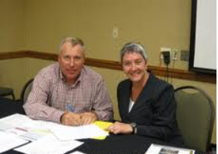
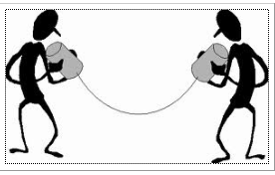


Simplicity!
Getting To The Real Need!
+
< Name > you could achieve even greater results if only . . . . . . . . .
Two People
Notes:
“
Transition: My name is John Bradford, and I am Senior Vice President of Consulting and Training Services for Profiles International. In my role I have the opportunity to work with clients of all sizes, from multiple business segments and with clients who do business all around the globe.

Slide 8

Simplicity!
Getting To The Real Need!
< Name > you could achieve even greater results if only . . . . . . . . .
Knowledge to acquire?
+
Skills to strengthen?
Experiences to gain?
Perspectives to broaden?
Qualities to enhance?
Strengths to leverage?
Notes:
“
Transition: My name is John Bradford, and I am Senior Vice President of Consulting and Training Services for Profiles International. In my role I have the opportunity to work with clients of all sizes, from multiple business segments and with clients who do business all around the globe.

Slide 9




Simplicity!
< Name > you could achieve even greater results if only . . .
K
S
S
EEP DOING
TOP DOING
TART DOING
www.profilesinternational.com
Notes:
“
Transition: My name is John Bradford, and I am Senior Vice President of Consulting and Training Services for Profiles International. In my role I have the opportunity to work with clients of all sizes, from multiple business segments and with clients who do business all around the globe.

Slide 10

COMPLEXITY!
This isn’t
realistic or
practical
www.profilesinternational.com
Notes:
“
Transition: My name is John Bradford, and I am Senior Vice President of Consulting and Training Services for Profiles International. In my role I have the opportunity to work with clients of all sizes, from multiple business segments and with clients who do business all around the globe.

Slide 11
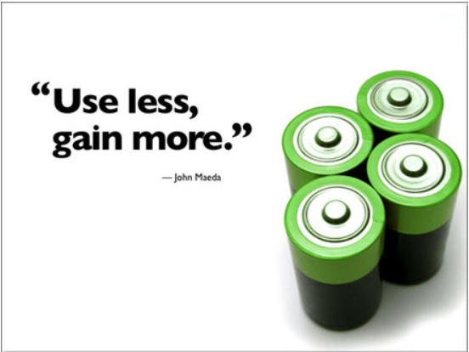
Complexity
Notes:
“
Transition: My name is John Bradford, and I am Senior Vice President of Consulting and Training Services for Profiles International. In my role I have the opportunity to work with clients of all sizes, from multiple business segments and with clients who do business all around the globe.

Slide 12



How Do Leaders Develop?
Development is most impactful when oriented to the 70/20/10 model
70% Experience Based
20% Relationship Based
10% Education Based
Job changes
Assignments
Daily work
Special projects
Coaching
Mentoring
Communities
Feedback
Classes
Courses
Seminars
Certifications
Your company can only provide opportunities to learn. It is the leader’s responsibility to take advantage of these opportunities.
www.profilesinternational.com
Notes:
“
Transition: My name is John Bradford, and I am Senior Vice President of Consulting and Training Services for Profiles International. In my role I have the opportunity to work with clients of all sizes, from multiple business segments and with clients who do business all around the globe.

Slide 13
How Do Leaders Develop?
HAVE
AN EXPERIENCE
NATURAL
LEARNING
CYCLE
PLAN THE
NEXT STEPS
REVIEW THE
EXPERIENCE
DRAW CONCLUSIONS
FROM THE EXPERIENCE
Notes:
“
Transition: My name is John Bradford, and I am Senior Vice President of Consulting and Training Services for Profiles International. In my role I have the opportunity to work with clients of all sizes, from multiple business segments and with clients who do business all around the globe.

Slide 14
Meet Ron Sample
33 Years in The Industry
22 years as Grocery Store Manager
Hits labor dollars every week, sales flat
Customers like Ron because nothing ever changes in his store
Task driven manager who gets the most from his direct reports
He directs and expects others to respond
Does not cultivate strong relationships with his team.
Team does what they are told
Ron is resistant to new ideas
Ron Sample
www.profilesinternational.com
Notes:
“
Transition: My name is John Bradford, and I am Senior Vice President of Consulting and Training Services for Profiles International. In my role I have the opportunity to work with clients of all sizes, from multiple business segments and with clients who do business all around the globe.

Slide 15




Objective Data!
Ron Sample
Above
Surface
Observed
Behaviors
Inside
Intentions
Below
Surface

Slide 16

How Do Leaders Develop?
On-The-Job Development Process
Name
_____________________________
My Strength
_____________________________
My Opportunity
_____________________________
My Opportunity
_____________________________
Dial In
Dial Up
Dial Down
www.profilesinternational.com
Notes:
“
Transition: My name is John Bradford, and I am Senior Vice President of Consulting and Training Services for Profiles International. In my role I have the opportunity to work with clients of all sizes, from multiple business segments and with clients who do business all around the globe.

Slide 17
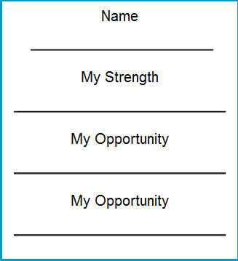

On-The-Job Development Process
Leadership
Awareness
Self
Situation On-The-Job
Leadership
Actions
Internal
To Yourself
Your Action
On-The-Job
Leader Engaging
With Employee
Results
+
_
Dial In, Dial Up, Dial Down A Behavior
Lessons Learned
©2012 Profiles International, Inc. All rights reserved.
Notes:
“
Transition: My name is John Bradford, and I am Senior Vice President of Consulting and Training Services for Profiles International. In my role I have the opportunity to work with clients of all sizes, from multiple business segments and with clients who do business all around the globe.

Slide 18
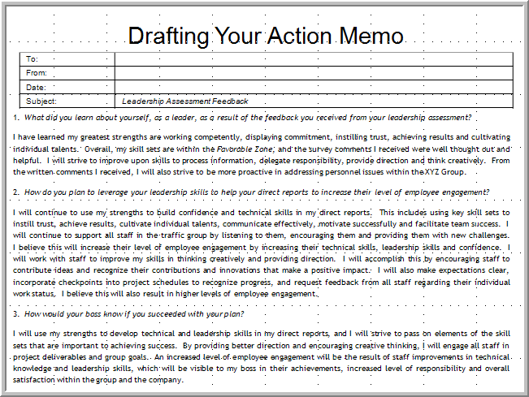
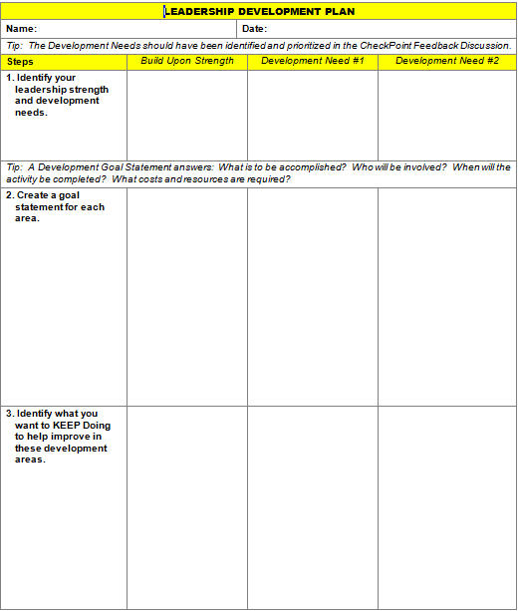
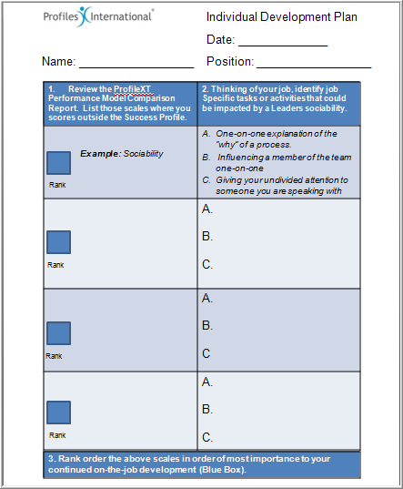
Types of Development Plans
  1.
  2.
  3.
  Result: Minimal without Accountability by Management!
Notes:
“
Transition: My name is John Bradford, and I am Senior Vice President of Consulting and Training Services for Profiles International. In my role I have the opportunity to work with clients of all sizes, from multiple business segments and with clients who do business all around the globe.

Slide 19
Drafting An Action Memo
  1.
Identify your focus questions:
1. What did you learn about yourself (strengths and development opportunities) as a leader as a result of the feedback you received from your leadership assessment?
2. What are you going to “keep doing,” “stop doing” and “start doing” as a leader so you continue to grow as a leader?
3. How would your boss know if you succeeded with your plan?
www.profilesinternational.com
Notes:
“
Transition: My name is John Bradford, and I am Senior Vice President of Consulting and Training Services for Profiles International. In my role I have the opportunity to work with clients of all sizes, from multiple business segments and with clients who do business all around the globe.

Slide 20
Drafting An Action Memo
To:
From:
Date:
Subject: | Leadership Assessment Feedback
1. What did you learn about yourself, as a leader, as a result of the feedback you received from your leadership assessment?
I have learned my greatest strengths are working competently, displaying commitment, instilling trust, achieving results and cultivating individual talents. Overall, my skill sets are within the Favorable Zone, and the survey comments I received were well thought out and helpful. I will strive to improve upon skills to process information, delegate responsibility, provide direction and think creatively. From the written comments I received, I will also strive to be more proactive in addressing personnel issues within the XYZ Group.
2. How do you plan to leverage your leadership skills to help your direct reports to increase their level of employee engagement?
I will continue to use my strengths to build confidence and technical skills in my direct reports. This includes using key skill sets to instill trust, achieve results, cultivate individual talents, communicate effectively, motivate successfully and facilitate team success. I will continue to support all staff in the traffic group by listening to them, encouraging them and providing them with new challenges. I believe this will increase their level of employee engagement by increasing their technical skills, leadership skills and confidence. I will work with staff to improve my skills in thinking creatively and providing direction. I will accomplish this by encouraging staff to contribute ideas and recognize their contributions and innovations that make a positive impact. I will also make expectations clear, incorporate checkpoints into project schedules to recognize progress, and request feedback from all staff regarding their individual work status. I believe this will also result in higher levels of employee engagement.
3. How would your boss know if you succeeded with your plan?
I will use my strengths to develop technical and leadership skills in my direct reports, and I will strive to pass on elements of the skill sets that are important to achieving success. By providing better direction and encouraging creative thinking, I will engage all staff in project deliverables and group goals. An increased level of employee engagement will be the result of staff improvements in technical knowledge and leadership skills, which will be visible to my boss in their achievements, increased level of responsibility and overall satisfaction within the group and the company.
Notes:
“
Transition: My name is John Bradford, and I am Senior Vice President of Consulting and Training Services for Profiles International. In my role I have the opportunity to work with clients of all sizes, from multiple business segments and with clients who do business all around the globe.

Slide 21
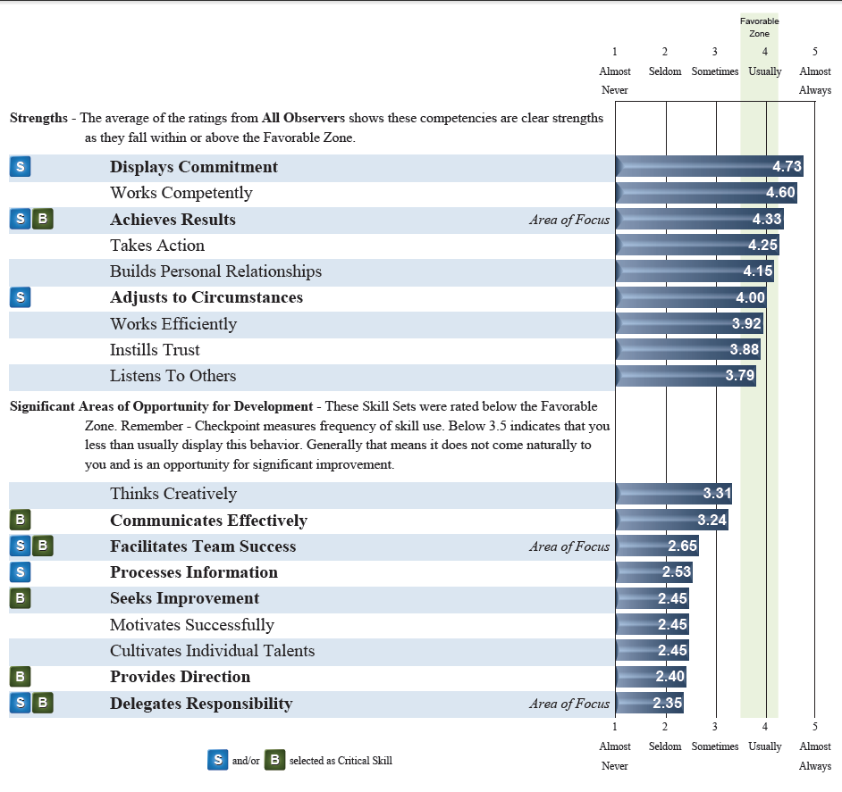
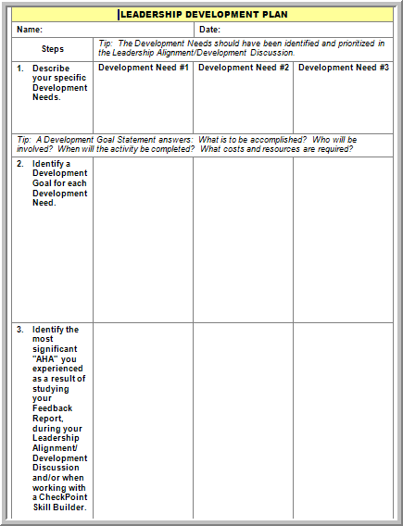
Types of Development Plans
Checkpoint360°
Actionable
Data!
  2.
Notes:
“
Transition: My name is John Bradford, and I am Senior Vice President of Consulting and Training Services for Profiles International. In my role I have the opportunity to work with clients of all sizes, from multiple business segments and with clients who do business all around the globe.

Slide 22
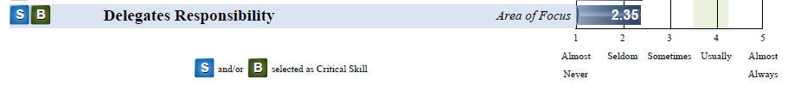

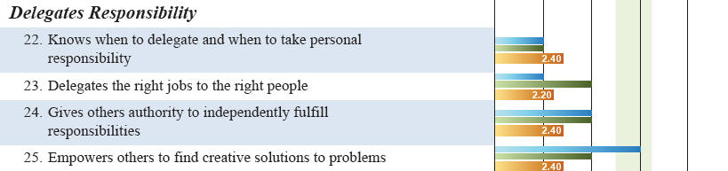
CheckPoint360 Actionable Data
Notes:
“
Transition: My name is John Bradford, and I am Senior Vice President of Consulting and Training Services for Profiles International. In my role I have the opportunity to work with clients of all sizes, from multiple business segments and with clients who do business all around the globe.

Slide 23
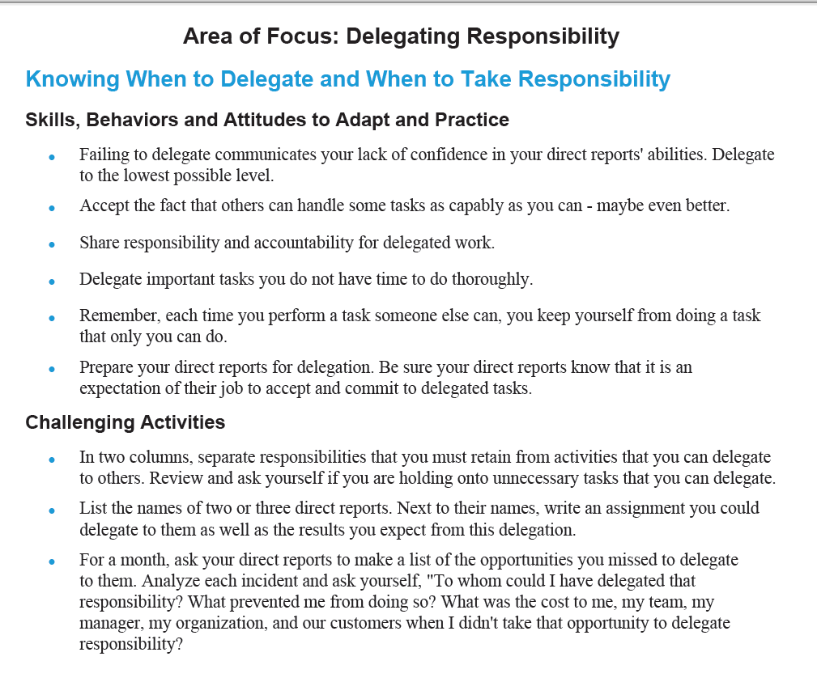

CheckPoint360 Actionable Data
Actionable
Data!
www.profilesinternational.com
Notes:
“
Transition: My name is John Bradford, and I am Senior Vice President of Consulting and Training Services for Profiles International. In my role I have the opportunity to work with clients of all sizes, from multiple business segments and with clients who do business all around the globe.

Slide 24
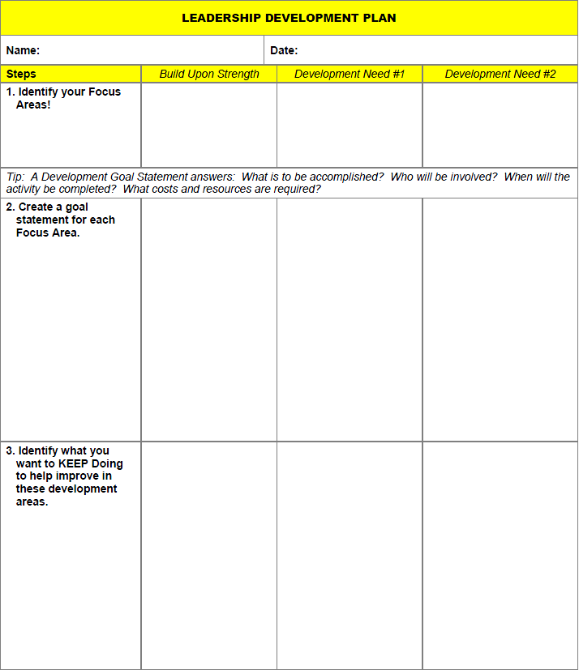


CheckPoint360 Actionable Data
Dial In!
Dial Up!
Dial Down!
Notes:
“
Transition: My name is John Bradford, and I am Senior Vice President of Consulting and Training Services for Profiles International. In my role I have the opportunity to work with clients of all sizes, from multiple business segments and with clients who do business all around the globe.

Slide 25
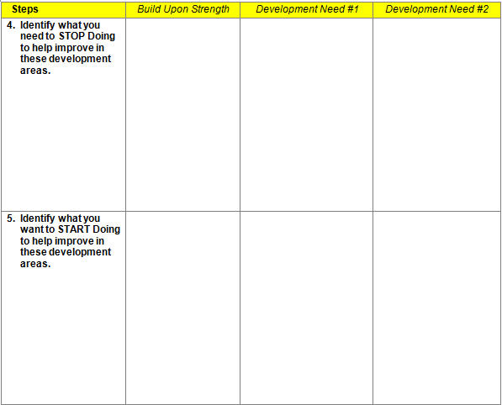
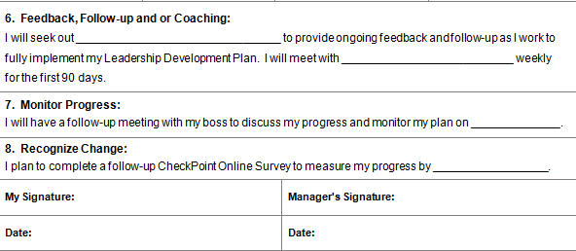
CheckPoint360 Actionable Data
Dial In!
Dial Up!
Dial Down!
www.profilesinternational.com
Notes:
“
Transition: My name is John Bradford, and I am Senior Vice President of Consulting and Training Services for Profiles International. In my role I have the opportunity to work with clients of all sizes, from multiple business segments and with clients who do business all around the globe.

Slide 26
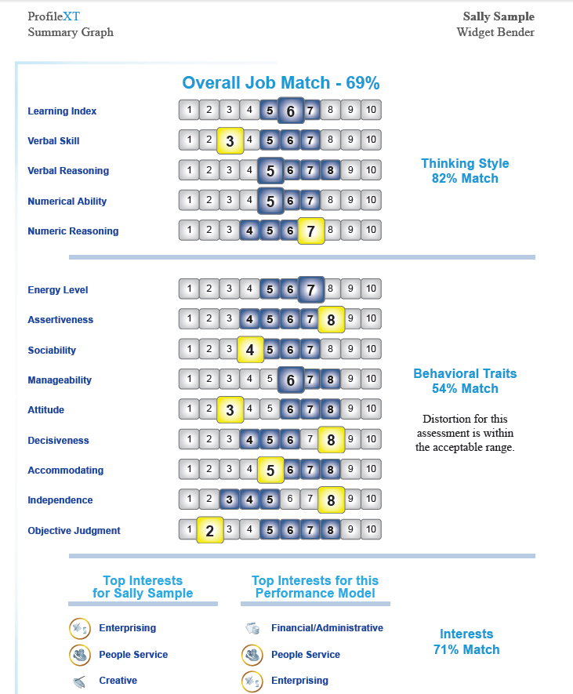
ProfileXT Actionable Data
Dial In!
Dial Up!
Dial Down!
www.profilesinternational.com
Notes:
“
Transition: My name is John Bradford, and I am Senior Vice President of Consulting and Training Services for Profiles International. In my role I have the opportunity to work with clients of all sizes, from multiple business segments and with clients who do business all around the globe.

Slide 27
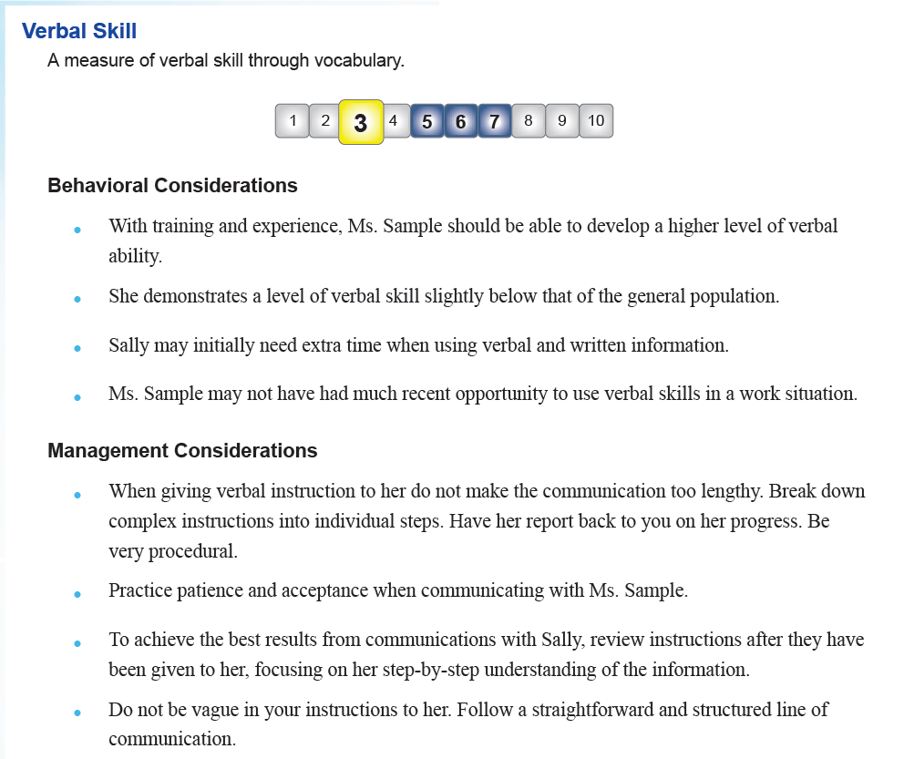

ProfileXT Actionable Data
Dial In!
Dial Up!
Notes:
“
Transition: My name is John Bradford, and I am Senior Vice President of Consulting and Training Services for Profiles International. In my role I have the opportunity to work with clients of all sizes, from multiple business segments and with clients who do business all around the globe.

Slide 28
ProfileXT Actionable Data
Dial In!
Dial Up!
Dial Down!
Notes:
“
Transition: My name is John Bradford, and I am Senior Vice President of Consulting and Training Services for Profiles International. In my role I have the opportunity to work with clients of all sizes, from multiple business segments and with clients who do business all around the globe.

Slide 29
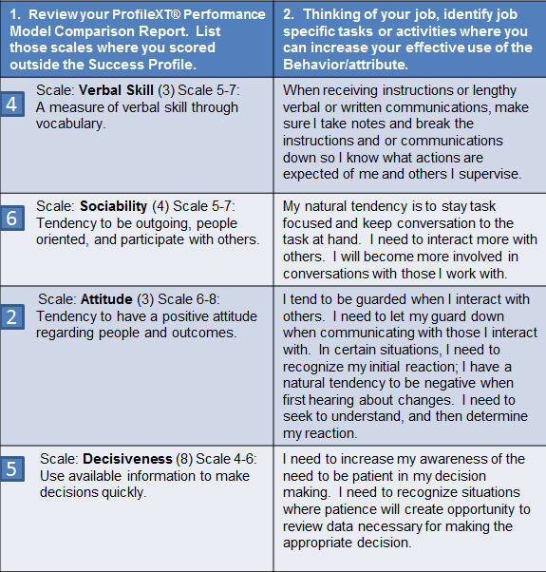
ProfileXT Actionable Data
Dial In!
Dial Up!
Dial Down!
www.profilesinternational.com
Notes:
“
Transition: My name is John Bradford, and I am Senior Vice President of Consulting and Training Services for Profiles International. In my role I have the opportunity to work with clients of all sizes, from multiple business segments and with clients who do business all around the globe.

Slide 30
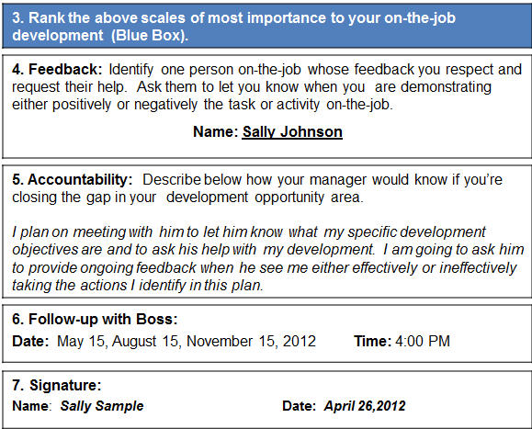
ProfileXT Actionable Data
Dial In!
Dial Up!
Dial Down!
www.profilesinternational.com
Notes:
“
Transition: My name is John Bradford, and I am Senior Vice President of Consulting and Training Services for Profiles International. In my role I have the opportunity to work with clients of all sizes, from multiple business segments and with clients who do business all around the globe.

Slide 31
Leadership Development Process
ADAPT
CATALYSE
TRANSFORM
Leadership Development Plan
M
E
A
S
U
R
E
D
R
E
S
U
L
T
S
R
E
S
U
L
T
S
R
E
S
U
L
T
S
Prescriptive
Online
Skill Building
+
1-1 Debrief
of Feedback
Strengths &
Development Needs
3 Way Action Meeting Leader, Manager, Leadership Coach
1-1
Leadership Coaching
Coaching Clusters
www.profilesinternational.com
Notes:
“
Transition: My name is John Bradford, and I am Senior Vice President of Consulting and Training Services for Profiles International. In my role I have the opportunity to work with clients of all sizes, from multiple business segments and with clients who do business all around the globe.

Slide 32
Leadership Development Plan – Next Ninety Days
Name_____________________
Date ________
Manager: _____________________
Starting Date _______ Ending Date ______
Leadership Developmental Goals: | Relationship Of Goals to the Achievement of Your HIS Goal or Success Measures | Skills Development | Developmental Activities | Deadline | Resources | Achievement Review | Date Completed
Leadership Development Goals – Next 90 Days: | This goal has organizational and personal relevance because: | This goal involve s developing the following competencies: | Three immediate development activities I will pursue: | Target dates for completion of activity: | Resources I will need: | This is how I will measure my progress: | This is the date I achieve my goal:
1
2
3
4
5
6
7
8
Leadership Development Goals – Next 90 Days
Organizational and personal relevance
Identify competencies/leadership skill sets
Three immediate actions – KSS
Target date for completion of activity
Resources needed
Measurement
Date achieved goal.
Leaders Signature & Date
____________________________________________
Approval: Manager Signature & Date
_____________________________________________

Slide 33
Leadership Development Plan – Fiscal Year 2015
Name_____________________
Date ________
Manager: _____________________
Starting Date _______ Ending Date ______
Leadership Developmental Goals: | Relationship Of Goals to the Achievement of Your HIS Goal or Success Measures | Skills Development | Leadership Developmental Activities | Deadline | Resources | Achievement Review | Date Completed
Leadership Development Goals – IHS 2015 Fiscal Year | This goal has organizational and personal relevance because: | This goal involves developing the following competencies: | Three development activities I will pursue throughout the IHS 2015 Fiscal Year: | Target dates for completion of activity: | Resources I will need: | This is how I will measure my progress: | This is the date I achieve my goal:
Leaders Signature & Date
____________________________________________
Approval: Manager Signature & Date
_____________________________________________

Slide 34

Simplicity
K
S
S
EEP DOING
TOP DOING
TART DOING
Planning is key to becoming a successful leader!
Notes:
“
Transition: My name is John Bradford, and I am Senior Vice President of Consulting and Training Services for Profiles International. In my role I have the opportunity to work with clients of all sizes, from multiple business segments and with clients who do business all around the globe.

