Slide 1
Leadership Charisma
The Impact of the Charismatic Leader on Engagementエンゲージメントに関するカリスマ的リーダーの影響力

Slide 2
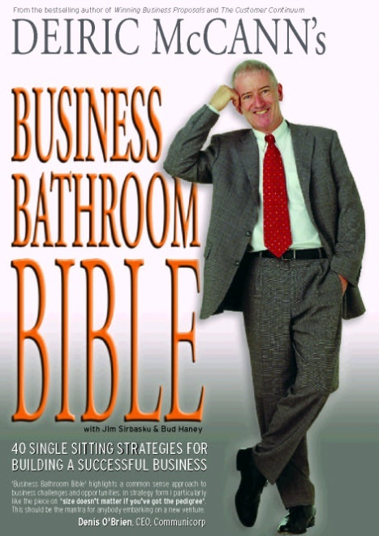
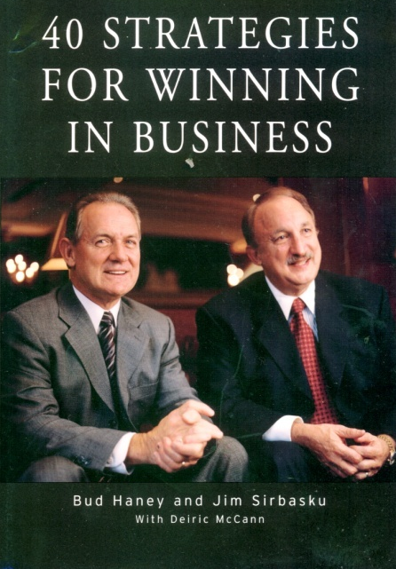
Deiric McCann
ビジネス書籍の
ベストセラー5冊出版
マネジメントに関する
1000以上の記事執筆
Executive Vice President
- 国際部門

Slide 3
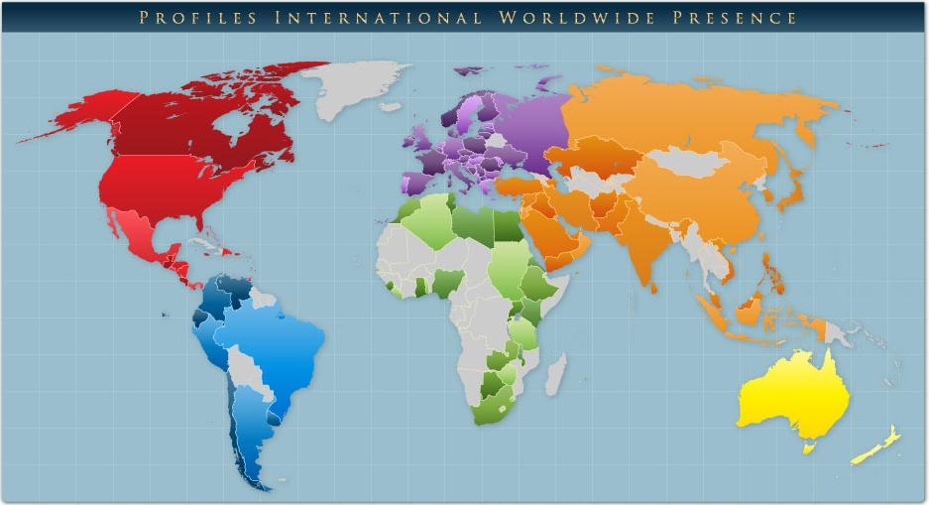
Global Reach – 120Counturies,33Languages

Slide 4
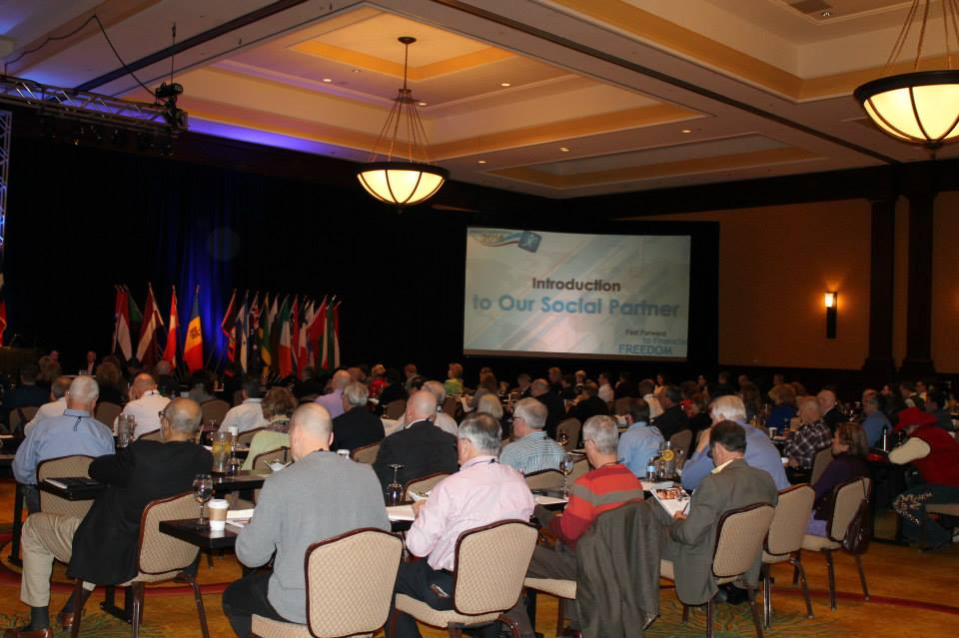
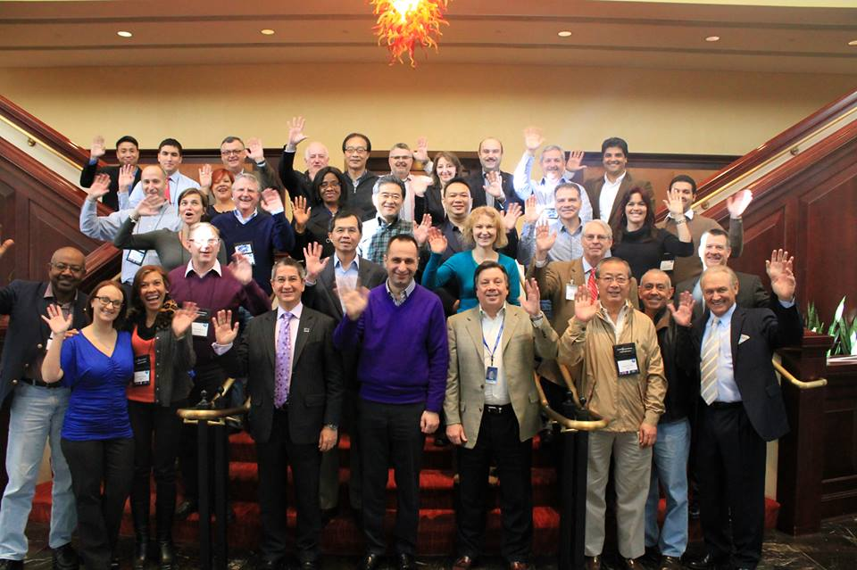
Employee Assessment Specialists
・1991年設立
・のべ4,500万 人材アセスメントを提供
・世界中に4万社の顧客
・US/テキサス州に約200名の社員

Slide 5
What’s the single most important challenge to leaders in any economy?
すべてのリーダーにとっての 一番の課題とは？
Getting Positive Result 肯定的な成果を生み出すこと
Notes:
Let me ask you a question: what’s the single most important challenge to leaders in this economy?
Ask the question on the slide – capture all of their responses on a flipchart. Talk through each briefly as you note it down.
Then show how everything they have all said really add up to one challenge to leaders in this economy: Getting Positive Results!
If anything positive comes from the sort of challenging economy we’ve all endured since end of 2008 it has to be the sense of focus that it gives everyone in business upon what really matters – bottom line results.
In the current economic climate every person in this room is more keenly aware than ever of the need to achieve maximum productivity from minimum resources – to get the results that our shareholders and owners demand of us.
There is nothing more important to ensure that our businesses push through the current challenges and position ourselves for success as things improve and normalize.

Slide 6
You trim costs 経費の削減
You reengineer your processes プロセスの再構築
In some cases you even reduce your workforce … 場合によっては、労働力削減…
Ultimately you’re left with the team that either will, or won’t, deliver the results you desire 望む成果を上げられようが上げられまいが、 チームの責任はあなたの責任です
Notes:
2008 made it clear to us all that 2009 would be a challenging year, and the fact that your organizations continue to exist is a tribute to the way that you and so many of your peers rose to that challenge – many organizations were not so fortunate.
In 2009 we all trimmed to the absolute minimum all costs that could be trimmed. In many organizations this meant losing some members of the team. We all spent a lot of time working on all of our processes to reengineer them so that they were maximally efficient and productive. It was often painful – but it worked.
In general, results during 2009 and 2010 indicate that these measures had gone a long way in holding off the worst effects of the global downturn – many organizations minimized the worst possible impact of the sudden downturn upon their bottom lines by taking such drastic actions.
But now that we have trimmed all of the costs we can, reduced our headcounts to the minimum practical and reengineered any processes we could, the only way that we can now positively impact our bottom line results from this point forward is through a focus on greatly increased productivity.
In all likelihood the team you now have left after this process is the one that you’ll depend upon to take you through these challenging times to the results you must target for the organization
Your challenge now is to get this team as productive as possible as quickly as possible.

Slide 7
A Critical Reality 重要な現実
The magnitude of this team’s contribution to your success will be directly proportional to how engaged they are with the organization and their jobs.
あなたの成功に対する「チームの寄与」は、組織と職務に対するメンバーの 「エンゲージメント」に比例する
Notes:
Which brings us to a critical reality that we must all face: the extent to which your team will contribute to the future success of your organization is directly proportional to the extent to which each and every member of that team are genuinely engaged with their jobs – the extent to which they genuinely want to help the organization to achieve the results it so badly needs from this point forward.
Employee engagement has never been more important.

Slide 8
What Drives Engagement 何がエンゲージメントを 生み出すか
?
Notes:
Presenter: Ask the question of the group: ‘What drives engagement?’
Use a flipchart to capture 10-12 responses from your audience. When you’ve captured them then talk through them briefly – then group them; i.e.:
Money & benefits - mention that the motivational life of a raise or a bonus is about the time from the award of the bonus to the receipt of the payment after tax!
Environment: Work environment is important – if it’s bad people won’t be as easily engaged, but it doesn’t naturally follow that they will be engaged if it’s good.
Relationships with the people around them / social dimension: yes, this is indeed a factor – one which the leader has considerable influence over in terms of how they fit people to the team
Job Satisfaction – yes, fit people into jobs that they are capable of doing, that fits their personality and behavior and sparks their interest and they will be most likely to be happy and engaged
The Boss: Yes! This is critical; even if someone has all of the above the boss can completely sabotage all other efforts and completely disengage people. Ask the questions: ‘Who here has ever worked for someone in a job they quite liked, for a package that was acceptable, with people they liked, but for a boss that turned them off? Were you engaged?’.
For each engagement driver the audience contributes ask them if it is ‘short term’ or ‘long tem’ in its engagement effect. Mark ‘S’ beside the short-term and ‘L’ beside the ‘long-term’.
You are looking for answers that lead you to your next slide – which tells them that our research shows that the two most important factors in driving engagement are job fit and leadership. Talk though this process until you have brought them in that direction (Job Fit and Leadership have substantial long-term engagement impact).

Slide 9
Engagement is Driven By エンゲージメントを生み出すもの
Job Fit ジョブフィット
Leadership リーダーシップ – too often forgotten! – 忘れがち！
Notes:
All of the factors that we have just discussed contribute something to the extent to which people are engaged with their jobs.
What our research has shown, however, is that the two single most important factors driving engagement are Job Fit and Leadership.
Job Fit is the extent to which there is a genuine fit between a person and their position – to be maximally productive a person must be matched to their jobs on three critical levels:
First, they must be capable of meeting the specific mental and intellectual demands that the positions makes on them – if they cannot meet those demands then how could they possibly be engaged?
Second, there must be a fit between the personality/behavior of the person doing the job and the environment & people they must work with. If a person does not fit the environment you give them to work in, or the people they must work with, then they will not be successful, and again they cannot possibly be engaged.
Finally, they must be matched to the job in terms of interest. They must WANT to do the work; they must be motivated by and interested in the work – or else they will never be fully engaged by the work.
Helping our clients to fit people to jobs is one of Profiles International’s main activities – and it is something we are very successful at; we will not be covering that topic in today’s briefing, but if you’d like to learn more about fitting people to jobs, just write ‘job fit’ on the back of your registration card and we can arrange to talk to you about it later.
For now, it is sufficient to say that, if people have a good fit with their jobs in all three of these areas, then it is possible to engage them.
Presenter - this point is critical: Poor job fit makes engagement impossible. But good job fit alone is not enough to ensure engagement. Once people have been well fitted to their jobs then it is not often recognized that the extent to which they are engaged will come down in very large part to the leadership they receive. The leader is the catalyst that sparks the engagement that leads to superior productivity. This is seen even in sports where a good coach can make an average talent great, and a great talent world-class; similarly a poor coach will very often be seen to get mediocre results from a world-class athlete. When it comes to people productivity and performance it is all too often forgotten just how importance leadership is in the mix

Slide 10
The Overlooked Role of The Leader in Engagement エンゲージメントにおけるリーダーの見過ごされやすい役割
“
… a great workplace is measured by the quality of three, interconnected relationships 職場の良し悪しは、次の3つの相互につながりのある関係の質により測定できる
…between employees and management 従業員とマネジメント
…between employees and their jobs/company 従業員と会社
…between employees and other employees 従業員同士
The relationship…関係性
“
Fortune Magazine’s “100 Best places To Work”
Notes:
Fortune Magazine’s ‘100 Best Places to Work’ research underlined the forgotten role of the leader in driving engagement. Their research found that an engaging workplace is driven by the relationship between employees and management – BY YOU!; By the relationship between employees and the organization – BY YOU!!; And by the relationships between employees and other employees – something which you, as the leader, directly impact through the work environment you create.
Bottom line: REAL engagement begins and ends with the leader. If you are an engaging leader then your people will be engaged – if not, then it matters little what else you do you won’t engage your people to the maximum extent – and you’ll miss the significant additional productivity and profitability that can result from high engagement levels.
Profiles has been working in the development of world class leaders since 1990. Every year we assess millions of leaders worldwide. When we researched the connection between the actions of leaders and employee engagement levels we were stunned to find that there was little of any practical use written on the topic – we couldn’t find anything that provided a practicing leader with a step-by-step guide to leading in a way that would enhance the engagement of the people he or she is leading.
So we decided to do our own research.

Slide 11
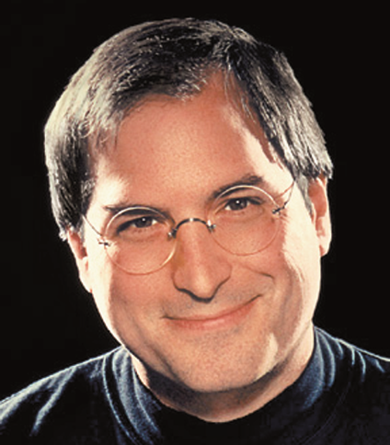
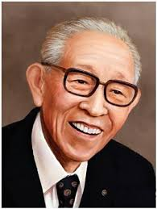
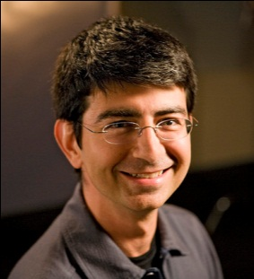
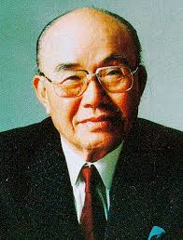
The Common Thread 共通のテーマ
Engagement/
エンゲージメント
“働く人が組織に対して 思い入れを持ち、 より自発的に仕事で 努力したいと思う影響力”
Charisma/カリスマ
“リーダーが有する特別な性質。周囲の人から肯定的な印象 を持たれ、忠誠心と献身 を刺激する要素”
Notes:
Our research team spent months trawling through all of the formal research available on the topic and, when that didn’t yield anything very useful, we started to study those leaders who had a reputation for inspiring their people to high levels of engagement.
In our research we looked very closely at people like Steven Jobs of Apple, Richard Branson of Virgin, Mary Kay of Mary Kat Cosmetics, Pierre Omidyar of Ebay, Oprah Winfrey and dozens more.
It was obvious that there was some common thread, that these leaders shared something in common when it came to engaging people and getting incredible results from them.
<CLICK>They very clearly engaged their people at a very high level – getting extraordinary results from them in the process.
<CLICK> During that research we saw one word come up again and again when these people were mentioned – charisma.
What struck us most was just how close the definition of charisma is to the definition of engagement – look at them here side by side: what’s clear is that they are two sides of the same coin. Leaders who have charisma will inspire in their people the allegiance and devotion necessary to convince them to invest greater discretionary effort in their work. Leadership Charisma drives engagement.

Slide 12
We defined a more practical 実践的な「カリスマ」を定義します。 それは・・・
‘commercial charisma’ …ビジネス上のカリスマ
Notes:
One of the problems with the word charisma is that it has been around so long that its meaning has been expanded to mean lots of different things to different people. The charisma we mean when we refer to movies stars has no relation whatever to the term charismatic as applied to Charismatic Christians, for example.
To avoid any confusion we felt that we needed to define that specific type of charisma demonstrated by a leader who is so successful in engaging his or her people that they get the sort of high-end productivity and profitability results achieved by high engagement organizations. Our more ‘commercial charisma’ would have a very specific purpose – to help leaders achieve the best possible results from their people.
To differentiate it from the charisma defined in the dictionary we called our new measure ‘Leadership Charisma’. Leadership Charisma is what you have if the way you interact with your people creates extraordinarily high levels of engagement and creates strongly motivated followers.

Slide 13
Leadership Charisma
“カリスマ的リーダーは、働く人が組織の目標に 向かって精神的にも知的にも努力できる 職場環境を創造し、維持していきます。
周りの人をエネルギッシュかつポジティブ にすることで、最善を尽くさせます。
そのうちに、人がもっと頑張りたくなるような 共通の目的意識を作り出し、プライベートの時間 までも仕事に捧げる人も出てくるほどになります。”
- ‘Leadership Charisma’, Haney, Sirbasku, McCann
Notes:
We started by defining the impact that leaders with high levels of this Leadership Charisma have upon their people.
We described the results we saw these exceptional leaders achieve in the terms you see here. Look at the key elements:
‘…creates an environment where people are emotionally and intellectually committed…’,
‘…builds an energetic and positive attitude in others…’,
‘…creates a common sense of purpose where people are more inclined to invest extra energy and even some of their own time in their work…’
Having defined the results that these enormously successful, inspiring and productive leaders achieved, then all we had to do was figure out what it was that they did in their day-to-day interactions with their people to drive this enormous impact upon people.
That took a lot of research…

Slide 14
The Research: What We Did 我々が行ったリサーチ
40,000 manager-leaders assessed for their leadership charisma…
4万人のマネジャーが
『リーダーシップカリスマ』
アセスメントの対象
…by almost 400,000 ‘Direct Reports’
回答した「部下」は40万人
Notes:
We were fortunate that we have a complete online leadership development system, called the Checkpoint 360.
Using the Checkpoint system, leaders are assessed by their ‘bosses’, their peers and their direct reports on how effectively they lead on a day to day basis.
To do this a leader is rated on how effectively they employ 70 key behaviors that almost 20 years of research has shown are the behaviors that are common to very highly effective leaders.
Hundreds of thousands of leaders globally pass through this system every year
In 2010 we added an extra question to the Checkpoint. sing our definition of Leadership Charisma almost 400,000 people worldwide were asked to rate their 40,000 leaders on the extent to which they found them charismatic.

Slide 15
The Research: What We Found リサーチにより発見したこと
It ALL comes down to behavior! すべてを行動にまで落とし込む
ANYONE can learn to be a charismatic leader学ぶことで誰でもカリスマ的 リーダーになれる
Notes:
At that point we not only had ratings of these 40,000 leaders on the 70 key leadership behaviors, but we also had their leadership charisma ratings – so we were able to identify which of the 70 leadership behaviors were the ones that specifically drove a charismatic impact upon the direct reports of these leaders.
Our research showed that a leader’s charisma, the extent to which she or he fully engages their people, is dependent on nothing other than a very specific set of behaviors. Those leaders who practice those behaviors daily in their interactions with their people are perceived as charismatic; those who do not practice them are not so perceived.
So ANYONE can become a charismatic leader; we identified 26 very specific leadership behaviors that any leader can learn to apply to create a charismatic impact upon their people – with all of the engagement and productivity benefits that this Leadership Charisma brings with it.
We used those 26 behaviors to drive the fourth section in the book you will receive today for attending our event.

Slide 16
No one
has charisma
生まれつきのカリスマはいない
Notes:
As leaders it is critical that we recognize one very important thing about charisma – NO ONE HAS IT!
That’s right – no one has charisma. Charisma is not an attribute you either have or do not have. It’s not the ‘God given gift’ that the Greeks thought it was.
No, charisma is what other people say you have when they like the way you deal with them – the way you talk to them, listen to them, interact with them: the way you BEHAVE with them.
You do not have charisma until someone decides you have and, in a workplace situation the ‘someone’ you want to impact in this manner are the people who work for you – those people from whom you want to get maximum engagement, and maximum productivity.
What’s more, you have a charismatic impact upon people only for as long as your behaviors appeal to them.
This is a key point: charisma begins, end ends, with others.
If you want to get maximum engagement and productivity from your people then you have to have leader behaviors that causes them to become engaged.
Before we get into looking at some of the behaviors that have this charismatic and engaging impact I’d like to make you a gift.
<Name> is handing out a very brief survey – please take a few minutes to complete this survey right now. <Click>

Slide 17
Leadership Charisma: 2つの原則
WIIFM
The Charismatic Equation カリスマ方程式
Notes:
We’re now going to spend some time looking at the key charismatic behaviors you must master to have a consistent charismatic impact upon your people.
But before we do that I’d like to share with you two key principles that we uncovered as we undertook the huge amount of research that underpins this book.
If you take nothing else away from today’s seminar, if all you remember and apply from this presentation are these two key principles then I guarantee you’ll raise your charismatic impact upon your people dramatically.
Let’s look at WIIFM (pronounced ‘wiffum’) and the ‘Charismatic Equation’.

Slide 18
WIIFM What’s in it for me?
Notes:
I do not mean this in any negative sense whatever, but when you strip away all of the niceties, all the layers of ‘proper’ behaviour that define the way we act and talk with others, all the social norms etc., what informs most of what we do is self-interest.
Even the most altruistic person asks ‘WIIFM’ – what’s.in.it.for.me? The answer for the true altruist is the sense of doing good by other people; that’s what interests them – so in doing good for others they are actually ultimately acting in their own self interest!
So, it follows that people who follow leaders, who find them charismatic, must be seeing some-thing, or things, in that person which they believe can help them further their own self-interests.
Therefore, if we can identify what constitute our people’s self-interests, and if we can ensure that we honestly and diligently behave in a manner that help others to achieve their self-interests then people will want to follow us.
Leaders who are seen to be charismatic in the eyes of their people are those who make it their business to always know precisely what it is that interests and motivates their people, what each of them wants from their lives and careers – and then make it their business to identify how each person’s self-interests are served by helping the organization achieve what it needs to achieve.
We’ll explore that more in a moment when we look at some specific charismatic behaviors – for now let’s look at the second key principle I mentioned: the ‘charismatic equation’.

Slide 19
The ‘Charismatic Equation’ カリスマ方程式
‘The extent to which you are perceived as being charismatic is directly proportional to the extent to which people either feel or fare better after each interaction with you’.
自分自身のカリスマ性の受け取り方は、 周りの人の受け取り方と比例している。 交流があればあるほど、その傾向は強まる。
- ‘Leadership Charisma’, Haney, Sirbasku, McCann
Notes:
The charismatic equation is a really very sensible and straightforward principle that explains what gives a person charismatic appeal. (Presenter: read the slide content aloud slowly). In simple terms: if I feel better or do better as a result of spending time with you, then you are charismatic for me. It’s that simple.
Charismatic Leaders make it a point to ensure that every interaction with their people is focused upon raising the self-esteem, self worth and capabilities of their people.
As we work through the rest of this briefing, especially when we look at some specific behaviors, bear these two principles in mind.
You’ll see that they underpin and explain why each and every one of the charismatic leader behaviors are so effective in raising a leader’s charisma.

Slide 20
ANYONE can Learn to be a Charismatic Leader 誰でもカリスマ的リーダーになれる：5つの重要行動
Be a Beacon of Positivity 「ポジティビティ」の案内役となる
Communicate Effectively 効果的にコミュニケーションを図る
Tailor Your Vision 自分のビジョンを語れる
Be Energetic & Enthusiastic エネルギッシュかつ情熱的になる
Recognize the Greatness in Others 周りの人の「偉大さ」を認める
Notes:
Put the title of this slide up (but not the bullet-points) and then ask:
“Given what we’ve said so far what would you speculate are the leader’s behaviors that our research suggested are most responsible for driving leadership charisma and engagement?”
Again, map some of their responses and talk through them. Focus particularly on those that you know amongst the six you’re about to show on your next slide.
Introduce the six bullet-points and then comment:
Let me make an important point again: these are all behaviors. You do not have to be the sort of person for whom these things comes naturally. Once you know what behaviors are required you can make the decision to develop those behaviors in yourself – to nurture a charismatic relationship with your people that engages them in producing superior results. ANYONE can learn to do this.
So now that you have a good feel for the key principles that underpin all charismatic behavior let’s look in a little more detail at six of the most key charismatic behaviors – and how you can make these a standard part of the way you work day to day in leading your team.
Here are the six most critical areas that the research identified for focus – the book looks at a few other areas, but we’ll focus today upon the most critical six areas for you in building your charismatic leader’s persona.
We’ll talk through each of these briefly, first let’s look at communication.

Slide 21
1. Be a Beacon of Positivity 「ポジティビティ」の案内役
Notes:
We’ve already touched upon the need for positivity. Even the most hard-bitten and cynical of your people will appreciate you taking a positive ‘what-we-CAN-do-now’ attitude in even the most difficult and negative of situations – even if they don’t show this appreciation.
Negativity is not motivating, engaging or charismatic. Negativity is highly contagious and corrosive. Negativity is something no leader can afford. The opposite of a leader is a pessimist!
No one is 100% optimistic all of the time – but there is an enormous amount of research outlined in the book showing a very direct connection between achieving success and the approach of taking what positive action you can in any situation and real success.
Positivity for leaders is not about becoming a Pollyanna who refuses to face up to realities. It IS about facing up to difficult realities and realizing that there is ALWAYS some action that you can take, however small, that will move things in a more positive direction. Charismatic leaders develop the habit of finding that action and taking it – however grim things look and however inconsequential that action may seem. Charismatics understand the power of even the smallest actions – especially in motivating those around them to shake off the inclination towards a ‘deer in the headlights’ reaction to adversity.
This is something most of us have to learn – and the book details all of the research that proves the effectiveness of this positive psychology – and provides a set of steps for raising your own positivity.
Become ever more positive and you become ever more charismatic.

Slide 22
2.9013?
“The Losada Line”〝ロサダライン”
Notes:
Do you know the significance of this number?
For any leader this is an important number – but for the leader who aspires to charismatically inspire highly productive levels of engagement it is absolutely critical.
<CLICK> From an enormous amount of research Psychologist Marcial Losada found that to make a team successful the minimum ratio of positive to negative experiences, feedback and comments in interactions between a leader and his/ her people is 2.9013 – that is to say, unless team members receive almost three times more positive feedback than negative feedback the team cannot flourish. <Click>

Slide 23
Positivity / Negativity Ratio ポジティブ比/ネガティブ比
1:1
2:1
3:1
4:1
5:1
6:1
7:1
8:1
9:1
10:1
11:1
Team
‘Languishes’衰退するチーム
Creativity dies,創造性なし
relationships 関係性崩壊
break down & 生産性落ち込み
productivity dives
Team
‘Flourishes’ 勢いのあるチーム
Creativity thrives 創造性豊か
relationships are enhanced 関係性向上
engagement rise エンゲージメント向上
people work in ‘flow’ 活発な仕事ぶり
& productivity rises 生産性向上
The ‘Losada Zoneロサダゾーン
2.9013:1
The ‘Losada Lineロサダライン’
Charismatic & engaging leaders focused on keeping their
environment & people in the Losada Zone 仕事にエンゲージするカリスマ的リーダーは、 環境や人をロサダゾーンに置こうとする
Notes:
If that ratio falls below 3:1 relationships break down, creativity dies, engagement becomes impossible and the team falls apart.
Losada’s research suggested that the optimum level is about 5.6:1 or higher. When you achieve this sort of ratio the work environment becomes much more productive – relationships thrive, people don’t notice time go by at work (they get into ‘flow mode’) and productivity rises.
This sort of environment is highly attractive to us all, and those who create such an environment are invariably described as ‘charismatic leaders’.
Want to be come more charismatic? Find everything positive you can in every situation and create as many opportunities as possible to communicate those positive messages to your team members.
Every one of the remaining behaviors we’ll talk about can be used to raise the Losada Ratio of your team – EVERYTHING you do can be done in such a way that it enhances the positivity of the workplace – and people crave positivity.
That starts with the way you communicate with your people

Slide 24
2. Communicate Effectively 効果的にコミュニケーションを図る
Notes:
Of all of the behaviors that our research showed were at the heart of charisma and success, communication was by far the single most important skill set.
When we looked at the totality of what it took to be seen as charismatic, to be seen as someone that others would willingly follow, we found that more than 40% of that impact was generated by good communication.
Think about that: if all you mastered in this life were great communication skills then you'd already be more than 40% of the way to having a charismatic impact upon all of those you encounter.
Nothing will get you further or faster in this life than great communications skills.
As a leader the most important communication is 1-2-1 communication, because that’s where you’ll spend more of your time with your people.

Slide 25
1-on-1 Communications 1対1のコミュニケーション
Keep it upbeat 常にアップビートで
For heaven’s sake, listen! 頼むから聞いて！
Solicit ideas, opinions and suggestions
アイデア、意見や提案を求める
Create a comfortable climate for raising concerns
懸念を表明しやすい環境を作る
Notes:
The book goes into much greater detail on this topic – but let’s look at some of the most important things to get right in your everyday communication with your people <CLICK>.
First, we can all find as much negativity as we need in the people and the environment around us – especially in challenging economic times. No one needs it from the person who leads them – and nobody will be moved charismatically by a pessimistic or negative outlook. Keep your communications positive and upbeat – always take the most positive ‘can do’ approach in any situation, however dire. People want and need positive leadership.<CLICK>
You’ve heard it a million times: the best communicators are the best listeners. Learn to listen - genuinely. But don’t just passively listen, <CLICK> make it a point so look for ideas, opinions and suggestions from those who work for you – there is nothing with a greater charismatic impact than the good feeling that comes from a respected leader seeking your ideas and opinions.<CLICK>
And, when you get ideas or feedback that you don’t like, be prepared to hear people out. Ensure that it is always possible to raise concerns or contrary opinions – without fear of negative consequences. Some of the best ideas will not be your own – be open to others’ constructive rejection of your ideas or approaches.
Your book offers you a step-by-step guide to making your 1-2-1 communications maximally charismatic, and provides many other suggestions that will make an enormous difference to the way you deal with your people day to day.

Slide 26
3. Tailor Your Vision 自分のビジョンを語れる
Notes:
Vision is always critically important – but never more so than in challenging times.
When I say vision I do not necessarily mean the typical broad-ranging corporate vision that hangs framed in the foyer of most organizations’ offices – they have their role but they are frequently of little use in motivating and engaging employees on a day to day basis.
Remember the WIIFM principle? People are concerned first and foremost about their own needs and, in tough times that means their jobs, financial and career security; security for their families’ futures and so on.
The charismatic leader develops the ability to take the vision they have of where their department or organization must go and convert it into a form that is meaningful to each and every one of his/her people. Only when leader’s vision is presented in such a way that it will obviously help an individual achieve their own personal vision and goals does it become genuinely and personally engaging. Being seen to align your vision with the visions of those who work for you is highly charismatic. <Click>

Slide 27
…the best way to keep your stars (engaged) is to know them better 優秀な社員を定着させるには、社員自身よりも社員のことをよく知ることです。 - and then use that information to customize the career of their dreams その上で、その社員の理想とする キャリアをカスタマイズするために、 得た情報を用いるのです。
“
“
-Source: Timothy Butler & James Waldroop: “Job Sculpting”
Harvard Business Review - September-October 1999
Notes:
To do this you’re going to have to learn a lot about the people who work for you – you cannot tailor the way you present your vision unless you know what is important to each and every one of your people – their own career and life goals, their needs, their particular strengths and so on. In the book you’ll read a step-by-step strategy for getting close enough to each of your people that you can do this effectively. <Click?

Slide 28
Tailor Your Vision
What are their strengths? 彼らの強みは？
What are their development needs? 彼らの育成ニーズは？
What goals do they have for themselves? 彼ら自身のゴールは？
What does success look like for them?
どのような成功を彼らは描いているか？
What are their family circumstances? 家族の状況は？
What are their passionate interests? 何に一番興味がある？
What will they learn / how will they become more valuable helping you to achieve your vision? あなたのビジョン達成に役立つように、何を学び、 どうなってもらいたいか？
Notes:
Unless you know all of this about each of those who report directly to you then you simply cannot tailor your vision so that it becomes their vision.
The key message is: to be charismatic and engage your people fully you must know each of those people deeply enough to be able to tailor your vision so that its realization can be seen to lead to each of your people realizing theirs.

Slide 29
4. Energy & Enthusiasm エネルギッシュかつ情熱的に
Notes:
You’ll occasionally meet some energetic and enthusiastic people who
are not charismatic, but you’ll never meet a charismatic person who is not
energetic and enthusiastic.
The charismatic’s seemingly boundless energy, the perpetual motion that sees him or her take more decisive action, get more done and display more enthusiasm than anyone else, is hugely attractive.
Energy and enthusiasm are fundamental elements of charisma. To become
charismatic you will need to master them.

Slide 30
Emotional Contagion
感情は伝染する
“Results of our studies clearly indicated that leaders’ emotional expressions play an important role in the formation of followers’ perceptions of leader effectiveness, attraction to leaders and follower mood … リーダーの感情的表現は、フォロワーが抱くリーダーの 効果性や、魅力、そしてフォロワーの気分にとって 重要な役割を果たしている
… charismatic leaders enable their followers to experience positive emotions カリスマ的リーダーは、フォロワーに対して ポジティブな感情を与えられる…
…the behavior of leaders and managers can make a difference in the happiness and well-being of the followers by influencing their emotional lives リーダーの行動は、精神面でフォロワーの幸福や福祉に 貢献できる”
Joyce E.Bono & Remus Ilies
Notes:
Look what happens when you’re with someone enthusiastic. You automatically tune in and immediately start mimicking that person’s mood and behaviour – the psychologists call it ‘mood contagion’.
You have unconsciously decided that you like what you see and how he or she feels, and you set yourself up to get some of that ‘feel-good’ factor for yourself.
Remember how the ‘charismatic equation’ said that you are charismatic if people feel better after interacting with you? Tap into your natural enthusiasm and you’ll infect all of your people with the positive energetic buzz that comes from that enthusiasm.
For any leader enthusiasm is critical – for a charismatic leader seeking to engage his or her people to the maximum it is absolutely indispensable.

Slide 31
5. Recognize the Greatness in Others 周りの人の 「偉大さ」を認める
Notes:
This is another one of those principles that you hear is essential to good leadership – recognizing the actions of those who work for you. But do you know why it works?
There is one key reason that charismatic leaders get such great results from something as simple as making a point of recognizing when their people do a good job – and it is all to do with chemistry.
Our amazing brain chemistry plays a large part in the effectiveness of recognition. <CLICK>

Slide 32
Recognition is Chemical 承認の化学反応
“
Recognition for good work releases Dopamine in the brain, which creates feelings of pride and pleasure.
仕事を認められると脳内にドーパミンが
放出され、 誇りと喜びの気持ちで満たされる
Better yet, that Dopamine hit cements the knowledge that more of that behavior will create more praise, resulting in another Dopamine drench, and so on.
さらに、その行動を繰り返せば褒められるという
記憶をドーパミンが定着させることから、
また次のドーパミンを得る結果となる
“
‘In Praise of Praising Your Employees’, Gallup Management Journal
Notes:
When you give one of your people praise or recognition – and the higher the level of recognition the better – it triggers a release of the ‘feel good’ chemical Dopamine into their brains, increasing their sense of pride, wellbeing and pleasure.
Always makes sure that praise and recognition is warranted – never give it just because ‘it’s time she got some praise’. Make sure too that they know why they are getting your recognition. That way you prime your people's brains to understand that repeating the behavior that triggered the recognition will results in even more praise, which in turn results in further pleasure enhancing doses of Dopamine into their brains.
The more genuinely and intensely you praise someone the more intense the reaction. Public praise (in front of colleagues and others) is the gold standard.
For the charismatic leader one of the most powerful ways of activating the ‘charismatic equation’, and making people feel good about dealing with them, is the provision of recognition.
In your book we lay out a list of the various ways you can recognize people to trigger this effect, enhance your charisma, raise engagement, and rocket productivity.

Slide 33
Recognition is Psychological承認の心理学
The ‘Norm of Reciprocity
返報性の原理’
Notes:
Why do salespeople on cosmetics counters give away expensive free samples?
Why does the Hare Krishna follower give you a free book or a plastic flower?
Why do cash-strapped charities often give away relatively expensive items like pens?
Simply because they expect you to respond in kind, returning favor for
favor.
The Hare Krishna follower gives you your free book and then solicits a
donation; the cosmetics salesperson provides your free sample and then makes
you a special offer of something else. The charity sends you the free pen with
the appeal for a donation.
Why? Because it works! Most people naturally feel a sense of obligation
when someone treats them kindly. People will often go along with requests
from others who have done them some service, however small – even when that
service was unsolicited and even if the person rendering that service is someone
they do not like.
This universal human response is called the ‘norm of reciprocity’ and it is triggered in people when you give them the ‘gift’ of recognition.
For the charismatic leader one of the most powerful ways of activating the ‘Charismatic Equation, and making people feel good about dealing with them is the provision of recognition.
In your book we lay out a list of the various ways you can recognize people to trigger this effect, enhance your charisma, raise engagement, and rocket productivity

Slide 34
ANYONE can Learn to be a Charismatic Leader 誰でもカリスマ的リーダーになれる：5つの重要行動
Be a Beacon of Positivity 「ポジティビティ」の案内役
Communicate Effectively 効果的にコミュニケーション
Tailor Your Vision 自分のビジョンを語れる
Be Energetic & Enthusiastic エネルギッシュかつ情熱的になる
Recognize the Greatness in Others 周りの人の「偉大さ」を認める
Notes:
Put the title of this slide up (but not the bullet-points) and then ask:
“Given what we’ve said so far what would you speculate are the leader’s behaviors that our research suggested are most responsible for driving leadership charisma and engagement?”
Again, map some of their responses and talk through them. Focus particularly on those that you know amongst the six you’re about to show on your next slide.
Introduce the six bullet-points and then comment:
Let me make an important point again: these are all behaviors. You do not have to be the sort of person for whom these things comes naturally. Once you know what behaviors are required you can make the decision to develop those behaviors in yourself – to nurture a charismatic relationship with your people that engages them in producing superior results. ANYONE can learn to do this.
So now that you have a good feel for the key principles that underpin all charismatic behavior let’s look in a little more detail at six of the most key charismatic behaviors – and how you can make these a standard part of the way you work day to day in leading your team.
Here are the six most critical areas that the research identified for focus – the book looks at a few other areas, but we’ll focus today upon the most critical six areas for you in building your charismatic leader’s persona.
We’ll talk through each of these briefly, first let’s look at communication.

Slide 35
“Everything you do, or do not do, adds to, or subtracts from, your charisma as a leader”
あなたが実行する事、実行しない事のすべては、
あなたのリーダーとしての
カリスマ性を増すか減じるかの作用があります。
Start making changes today
to raise your charisma
(even small changes! )
例え小さな一歩でも今日から
あなたのカリスマ性を向上する歩みをスタートしましょう！
“Everything you do, or do not do, adds to, or subtracts from, your charisma as a leader”
あなたが実行する事、実行しない事のすべては、
あなたのリーダーとしての
カリスマ性を増すか減じるかの作用があります。
Notes:
The reality is that everything you do, or do not do, adds to, or subtracts from, your charisma as a leader.
This is an important finding. Everything about the way we behave in managing our people has an impact on how charismatic we are seen to be – and how engaged our people will be by us.
Even the smallest of behaviors can have an enormous impact upon how charismatic your people perceive you to be. <Click>
Think of a kaleidoscope. At the end of a tube are a series of carefully positioned mirrors and dozens of multi-colored beads. When you look down the tube you see a pattern that is a function of the positions of those beads in relation to the mirror – because the picture is made up of a series of reflections of the beads, every single bead has an enormous effect on the pattern you see. Let’s strop that movement before we all get hypnotized! <Click>
Now, if you turn the tube, and if even one bead shifts, then you get a brand new picture – even one single bead shifting can change the pattern dramatically. <click>
Leadership Charisma is like that. Our research shows that there are some very specific behavioral ‘beads’ – and if you change even one of these leadership behaviors in your day-to-day dealings with your behaviors are reflected from person to person in your team – back and forth again, and again. Just like any movement on the part of the little girl in this photo is reflected again and again.
Change the smallest of behaviors and then you can create a dramatically different perception of you as a leader. Employ all of the charismatic leader behaviors systematically and you become charismatic in the eyes of those who work for you.
Charisma is not a quality you have as an individual – but a reaction others have to the things you do – to your behaviors.
EVERYTHING you do matters.

Slide 36
What changes do I need to make
to raise my Leadership Charisma
リーダーシップカリスマを 向上させるには 私の何を変えるべきですか?
Notes:
So, you must be thinking: what would I have to change to raise my leadership charisma and get more engagement and productivity from the people who work for me?
Good question!

Slide 37
Where are you now? あなたの現在置は？
‘You cannot manage what you cannot measure ’
測定できないものはマネージできない
セルフリーダーシップカリスマ指数 Self Leadership Charisma Index (SLCI)
セルフリーダーシップカリスマ度 Self Leadership Charisma Quotient (SLCQ)
You have little idea what you’re doing that’s working 自分の行っていることで、何が良いことなのか、ほとんど分からない…
Notes:
It’s often said that you cannot manage what you cannot measure.
That’s why we created two objective measures of Leadership Charisma that will tell you how charismatic you are currently perceived to be – your Leadership Charisma Index (LCI) and your Leadership Charisma Quotient (LCQ). Once you know how charismatic you are right now you can start to work on raising your leadership charisma a step by step.
The Leadership Charisma Index is a measure of how charismatic the people who work for you perceive you to be today. Your rating will be somewhere between 0 and 100 – if your people see you as perfectly charismatic, demonstrating all of the charismatic leader behaviors all of the time, then you’ll score 100. The fewer of the behaviors you demonstrate the lower your score will be.
The Leadership Charisma Quotient computes the ratio your LCI with the average LCI of the 40,000 leaders worldwide who participated in our research – to give you a sense of how charismatic you are by comparison to other leaders worldwide.

Slide 38
Where are you now? あなたの現在置は？
Notes:
I’ll give you more details later in the session, but I’m going to arrange for everyone here to get a free report that provides you with an overview of what we call your ‘Self Leadership Charisma Index’. This personalized report will be delivered to you and you alone.
Please just complete the survey and hand it back when you’ve done so.
Please complete each items with whatever initially occurs to you as being the best description of how often you display the listed behaviors when dealing with your people day to day – from 5, ‘Almost Always’, down to 1, ‘Almost Never’.
There is no right or wrong in this survey – and the more honest you are with yourself the more valuable the results will be to you.
Presenter: wait until all have completed the survey and handed it back).
Thank you! Let’s look at the behaviors our research showed drive a leader’s charisma – and I’ll talk to you about your personalized report a little later in our session.

Slide 39
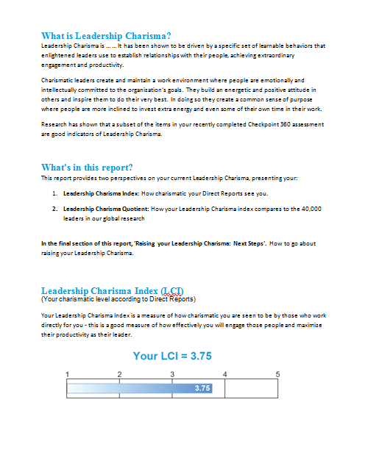
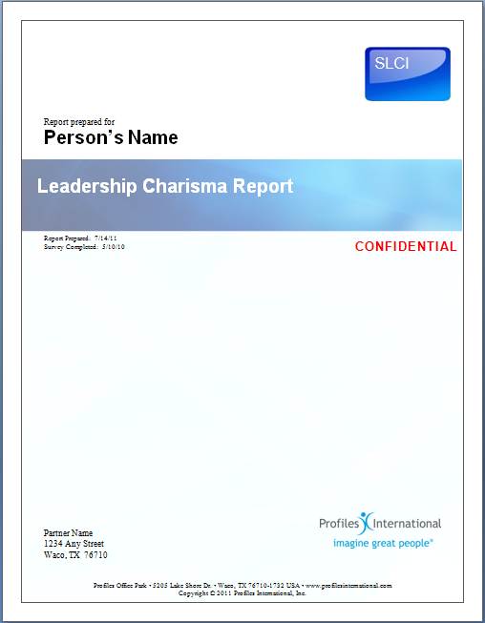
セルフリーダーシップカリスマ指数 Self Leadership Charisma Index &
セルフリーダーシップカリスマ度 Self Leadership Charisma Quotient
Notes:
Earlier you completed a survey that will allow us to provide you with a personalized report that provides you with a version of these two measures – your charismatic impact as seen through your own eyes.
We’ll have those reports ready for you in a day or two – and we’ll be in touch to arrange to walk you through your personalized report.
If you’d like to set an appointment here and now just talk to <name> or me before you leave and we’ll get it scheduled right away and get your report to you even more quickly.

Slide 40
Notes:
Before I close up this morning’s session are there any questions you’d like to ask on anything we‘ve covered this morning?

Slide 42
Leadership Charisma
The Impact of the Charismatic Leader on Engagement

