Slide 1
Utilizing HR Analytics to Improve Decision Making -Strategic Talent Assessment: ProfileXT-
HRD Group

Slide 2
Agenda
Background：Why Talent Assessment Tools
Our Solution：ProfileXT®
Client Case Study
Implementation Process

Slide 3
Background：Why Talent Assessment Tools

Slide 4
○ Foreseeable challenge to business
Decreasing working population in Japan
（Current：76 million 2030：67 million 2040：57 million）
Business initiatives and growth will not be achieved without sufficient and proper talent
Yes, new hires are necessary
Organization does not have enough talent?
Either way, how to identify talent is essential
High potential talent actually exists and needs development
Does your organization have an effective way to identify/measure your talent?

Slide 5
○ Business trend
Using big data analytics to drive better and smarter business decisions is becoming the norm.
Organizations are leveraging big data analytics on manufacturing, sales, marketing and operations to improve overall business performance.
Staff group | Focus | Information they bring
Finance | Economic and financial performance | Financial data (EVA, EBIDTA, cash flow)
Marketing/sales | Customer interest and patterns | Net promoter score Customer share Market share
Manufacturing | Operational efficiency | Productivity Quality Efficiency
HR | ? | ?
Challenge:
Lack of strategic data analytics in HR field

Slide 6
○ Our belief
Provide quantitative data to improve decision making
PLUS
Skills
Performance review
8.5
…
Thinking Style
Background
Experiences
Behavioral Traits
Reference
4.5
Attitude
Demeanor
Occupational Interests
7.8
Traditional HR practices – relying more on subjective factors
Scientific data from assessment
Talent assessments empower organizations by providing measurable data of people.

Slide 7
Our Solution:
ProfileXT®

Slide 8
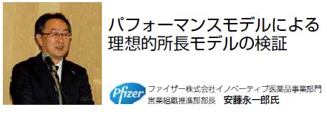
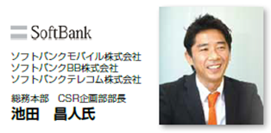
125 Countries, 33 Languages, over 40,000 clients
ProfileXT
Worldwide
In Japan
☑ Founded in 1991
☑ Distributed by over 10,000 partners across the globe
☑ Introduced to Japan in 2011. Clients in healthcare, IT, retail, chemical, financial services, apparel, construction and etc.
Success stories from clients.

Slide 9
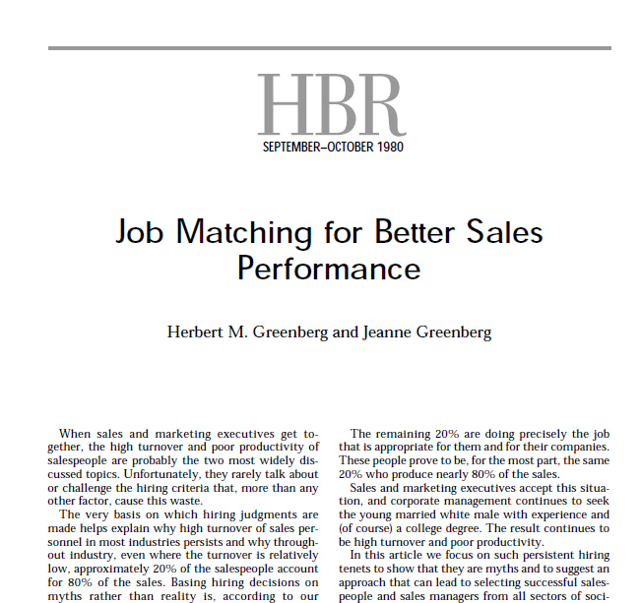
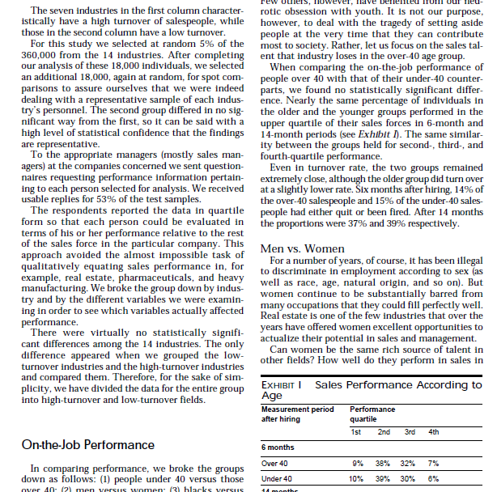
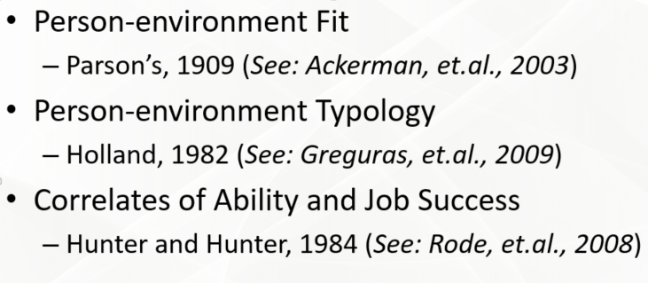
For twenty years a research followed 360,000 people in fourteen industries through their careers and found out that people who were fit with their jobs were 250% more productive than those who were not.
Theoretical Foundations
ProfileXT is a human resources assessment developed by Wiley
that helps identify people who fit most accurately in jobs.
Notes:
2nd Click
3rd Click
4th Click

Slide 10
The Cornerstones of Performance
Job-Fit: The missing third in identifying
Superior Performance
Résumé, Application, References
Skill Fit
Education,
Training,
Experience,
Skills, Etc.
Interview,
Integrity Assessment
Company Fit
Attitudes,
Values,
Demeanor,
Appearance,
Integrity
Job Fit
Thinking Style, Behavioral Traits, Occupational Interests
Job Match Assessment
Notes:
Here is something that we advocate with all of the clients you heard us mention earlier. We believe that there are cornerstones to performance. When you have someone that matches the requirements of the job in al three of these areas, you are more likely to have a productive, happy and long-term employee.
Skill Fit has to do how well a person’s education, training, skills and experience match specifically with what the job requires. For every job, there is a unique skill fit set that will most readily lend itself to success in the job
Company fit is a different proposition. It answers the question, “Is this the sort of person I want working anywhere in my company?”
Job fit is how well a person’s thinking or cognitive abilities, behaviors and interests match specifically with what the job requires. Just as there is a unique skill fit set in each job that will most readily lend itself to success, so too there is a unique job fit set. As we mentioned earlier, we provide the technology by which we can identify what that set is.

Slide 11
What ProfileXT does
Personal Characteristics
JOBFIT
Successful Job Characteristics

Slide 12
Employee Lifecycle Solutions
Recruitment
Development
Successful Job Characteristics
Pre-screening candidates
Identifying high potential talent
Selection
Areas ProfileXT helps
Deciding whom to promote and where to place

Slide 13
ProfileXT Measures Hidden Attributes for Job Fit
Total Person - Occupational DNA
Learning & Reasoning
Behavioral Traits
Occupational Interests

Slide 14
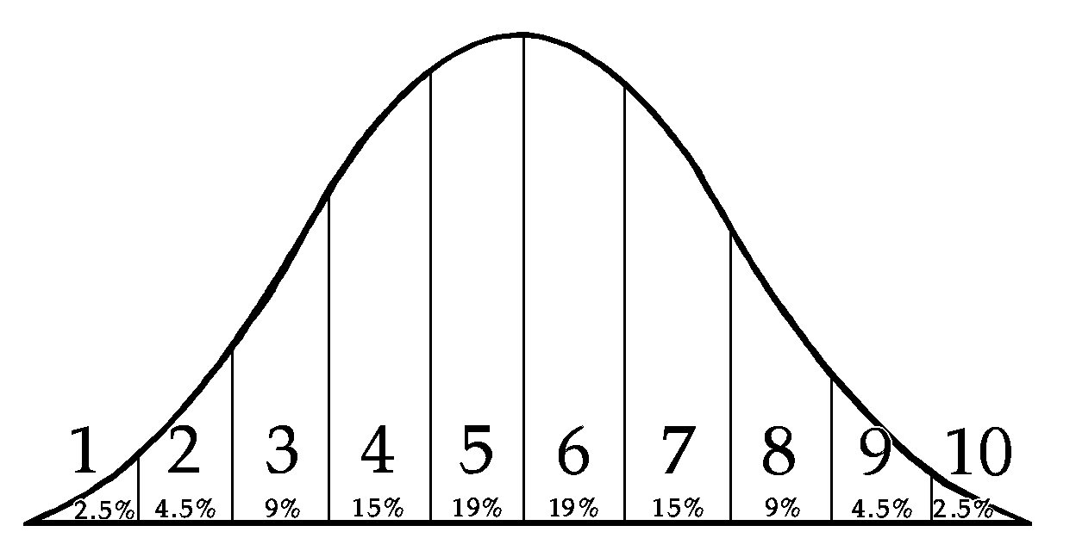
16%
68%
16%
What We Measure
Thinking Style
Learning Index
Verbal Skill
Verbal Reasoning
Numerical Ability
Numeric Reasoning
1
2
3
4
5
6
7
8
9
10
CAN they do the job?
1
2
3
4
5
6
7
8
9
10
1
2
3
4
5
6
7
8
9
10
1
2
3
4
5
6
7
8
9
10
1
2
3
4
5
6
7
8
9
10
Thinking Style
Energy Level
Assertiveness
Sociability
Manageability
Attitude
Decisiveness
Accommodating
Independence
Objective Judgment
1
2
3
4
5
6
7
8
9
10
1
2
3
4
5
6
7
8
9
10
1
2
3
4
5
6
7
8
9
10
HOW they do the job?
1
2
3
4
5
6
7
8
9
10
1
2
3
4
5
6
7
8
9
10
1
2
3
4
5
6
7
8
9
10
1
2
3
4
5
6
7
8
9
10
1
2
3
4
5
6
7
8
9
10
1
2
3
4
5
6
7
8
9
10
Behavioral Traits
Enterprising
Financial/Admin
People Service
Technical
Mechanical
Creative
1
2
3
4
5
6
7
8
9
10
WILL they love it?
1
2
3
4
5
6
7
8
9
10
1
2
3
4
5
6
7
8
9
10
1
2
3
4
5
6
7
8
9
10
1
2
3
4
5
6
7
8
9
10
1
2
3
4
5
6
7
8
9
10
Interests
Notes:
We used our Profile XT job-matching technology to help.
Let me tell you a bit about this tool.
(Provide your overview explanation of the Profile XT. Not too much detail. Remember, when we start looking at actual results and reports, we’ll be able to elaborate on some of the scales, especially those where we may see people not matching.)

Slide 15
Defining Successful Job Characteristics
-How ‘Performance Models’ Are Built
Top Performers
Use objective measures for identification
Job Analysis
Pending changes in job requirements
Library Of Models
Referring to o-net job description
Few or no Top Performers available
Over 1,000 Existing Performance Models
Supervisory Survey
Concurrent or Predictive Validity
…or any combination of the above

Slide 16
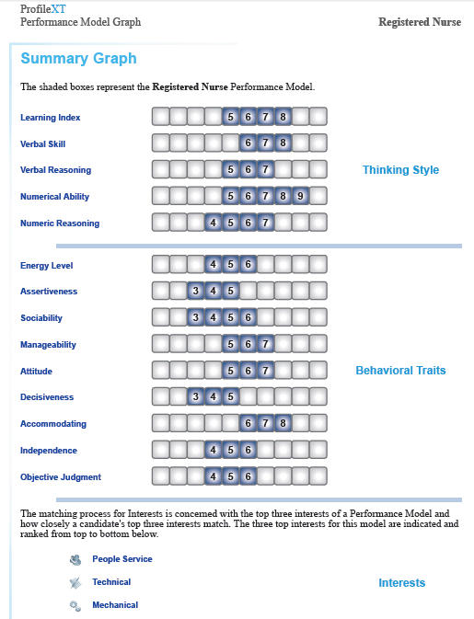
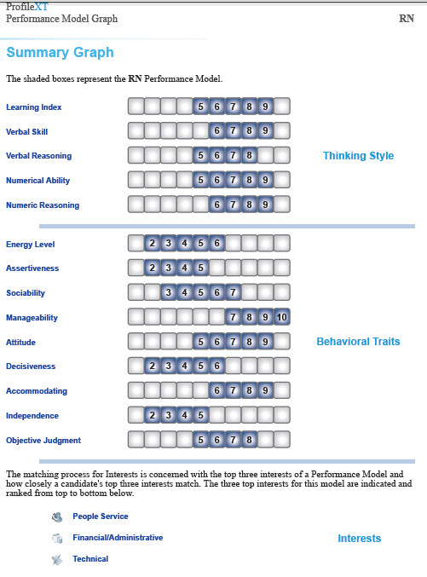
Same Position, Different Performance Models for Different Companies and Cultures
Performance Models for the same job title will look different from company to company due to company culture and job competencies required.

Slide 17
Two Candidates Matched to the
Performance Model
Candidates take the assessment and individual results are compared to the “Performance Model” for that position. An overall Job Match Percentage is generated.

Slide 18
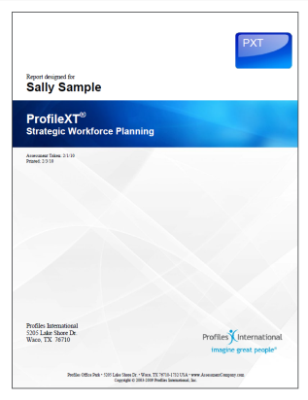
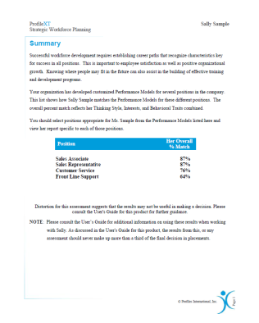
Individual Career Planning Report
Positions
Her Overall % Match
Candidates who lack Job Fit for one position can be instantly compared to other “Performance Models” within the organization to find a match maximizing training investment and career development for retention.

Slide 19
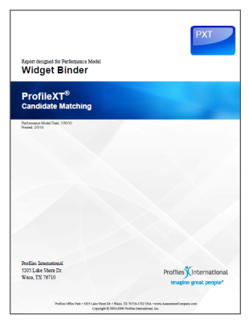
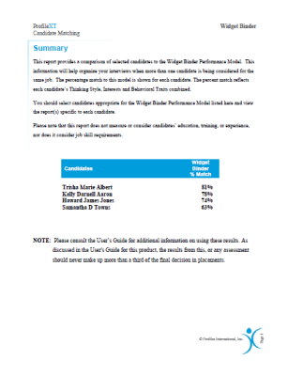
Leadership & Succession Planning Reports
Candidates
Manager Performance Model
% Match
The Succession Planning Report helps clients quickly and objectively identify potential top performers for any position.

Slide 20
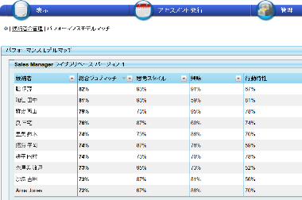
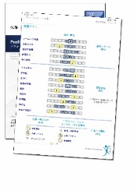
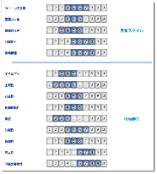
Technology - The Job Fit System
Administrators
Global Assessment Center
(GAC)
Multiple Reports in 33 Languages
Job Fit Analysis
PAC
PSC
Employee Information
Performance Model Creation
Assessment Generation
Candidates
GAC is a cloud system that can be administered and managed by the client to improve internal PDCA cycle in talent management.

Slide 21
Client Case Study

Slide 22
Hiring
Improving mid-career selection practices to reduce turnover.
Industry：Consulting Services
Participants：Over 100 candidates
2014
2015
Performance Model Creation
Performance Model Validation
High Performers Concurrent Study
Adding New High Performers
July
October
Challenges
Solutions
Results
Identify top performers
Improve selection process
Sustain a turnover rate below industry average
Turnover rate is down by 25%
15 millions saved in turnover costs
Improved selection process
Built a Job Match pattern based on top performers’ PXT results
Use PXT as part of the pre-hire screening process

Slide 23
Implementation Process

Slide 24
Implementation Process Overview
Phase I
Phase II
Phase III
Determine Candidates
Complete PXT Assessment
Client
Place Candidates
PXT Orientation
Executive Interview
Complete Job Analysis Survey
Kick-Off
Reporting
Profiles
Build Performance Model
Performance Model Validation
Set up GAC ・ Launch PXT
Analyze Results ・ Create Report

